Slide 1
Reducing on-farm emission in Cornwall through a community network
Hannah Jones, Farm Carbon Toolkit

Slide 2
Why farming
Agriculture is one of the only business that can
1. Produce food
AND, at the same time,
2.Take carbon dioxide out of the atmosphere

Slide 3
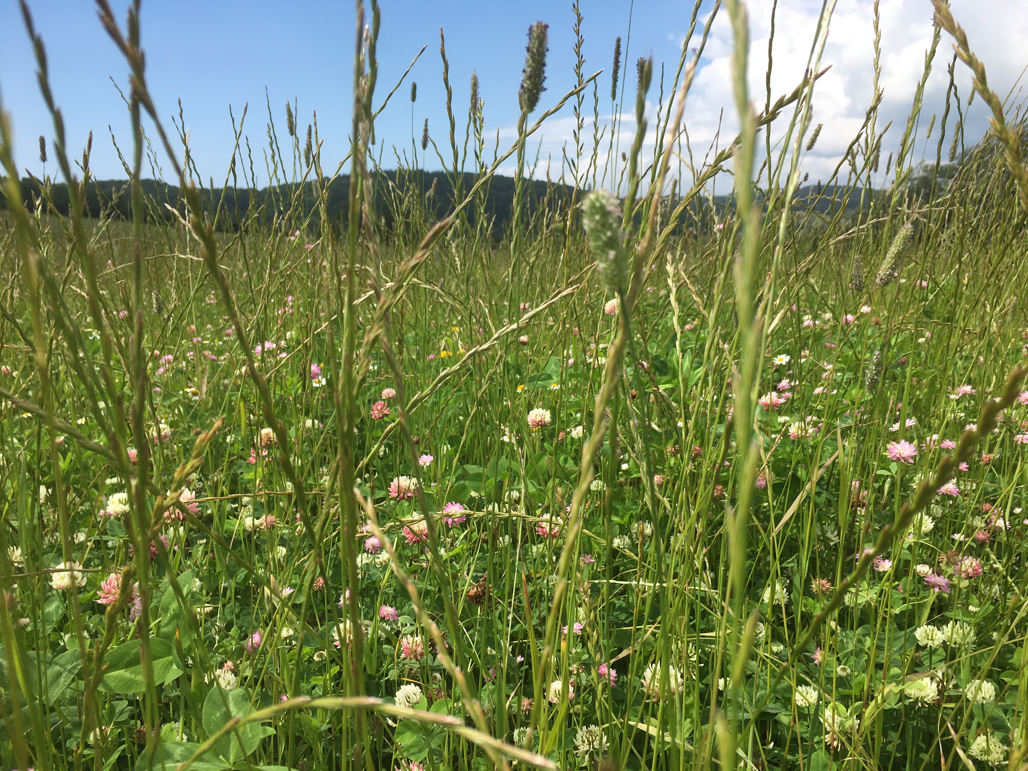

Slide 4
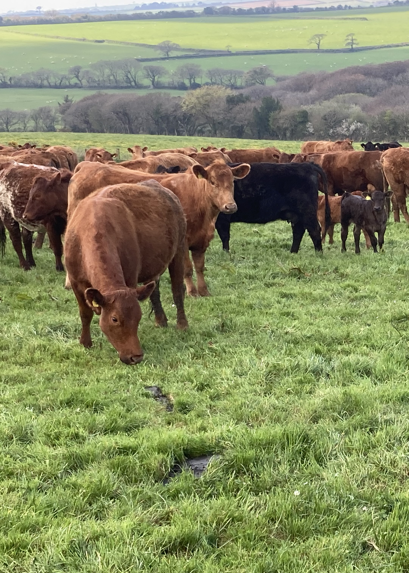
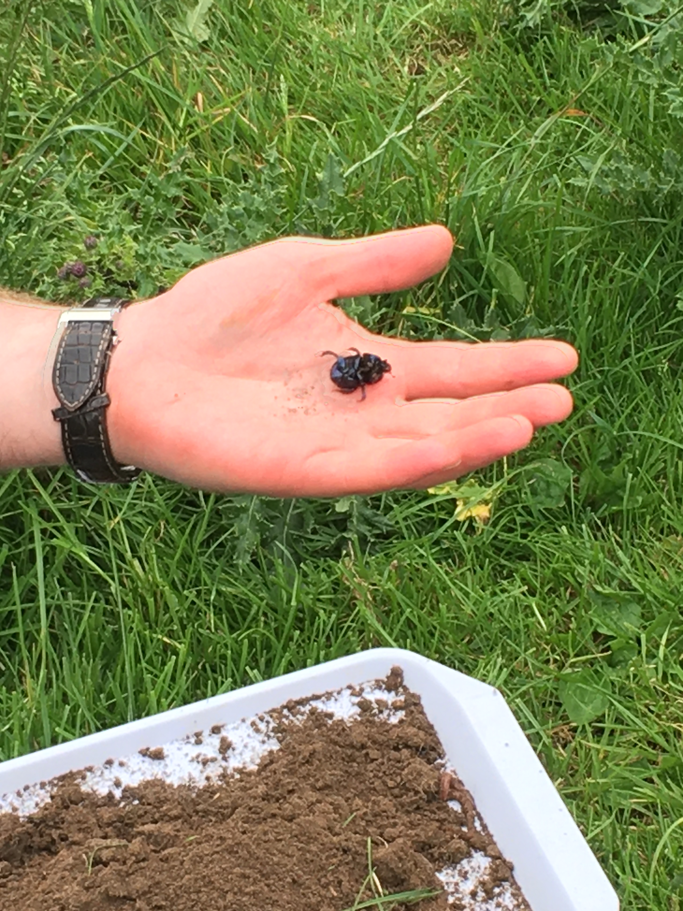
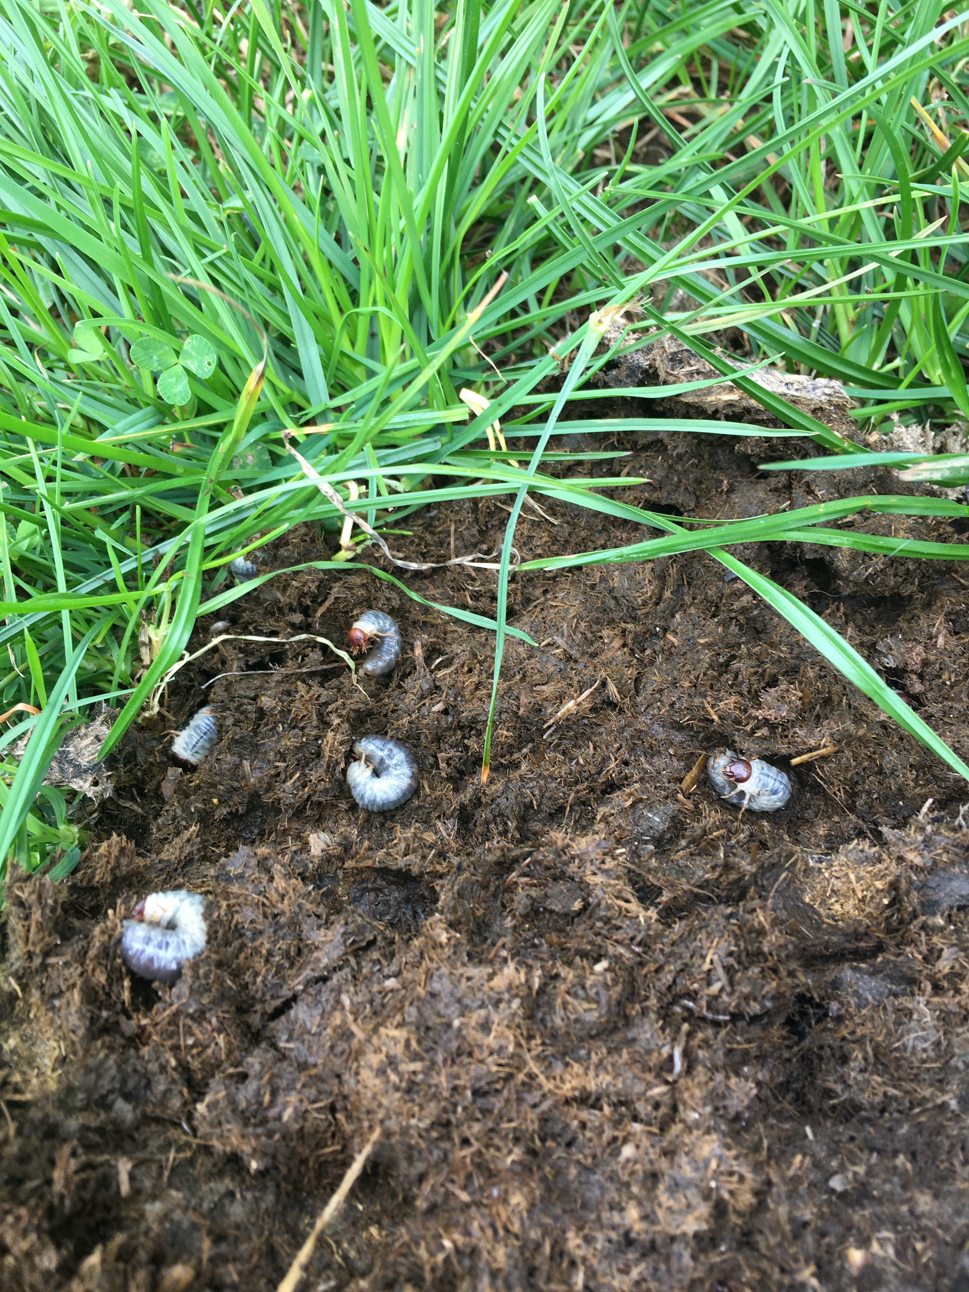

Slide 5
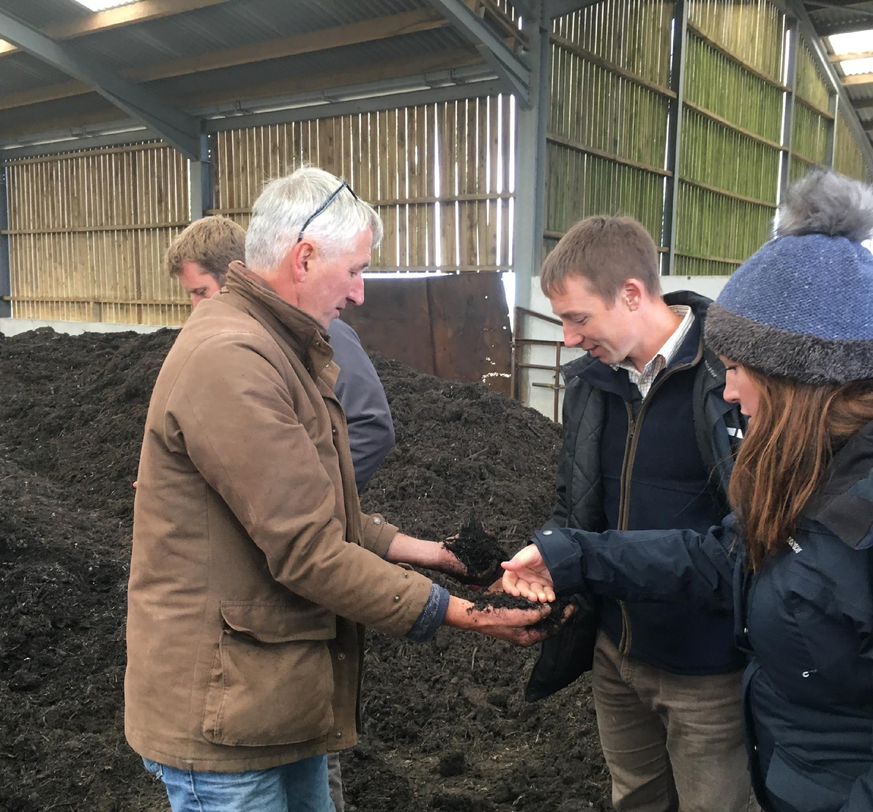
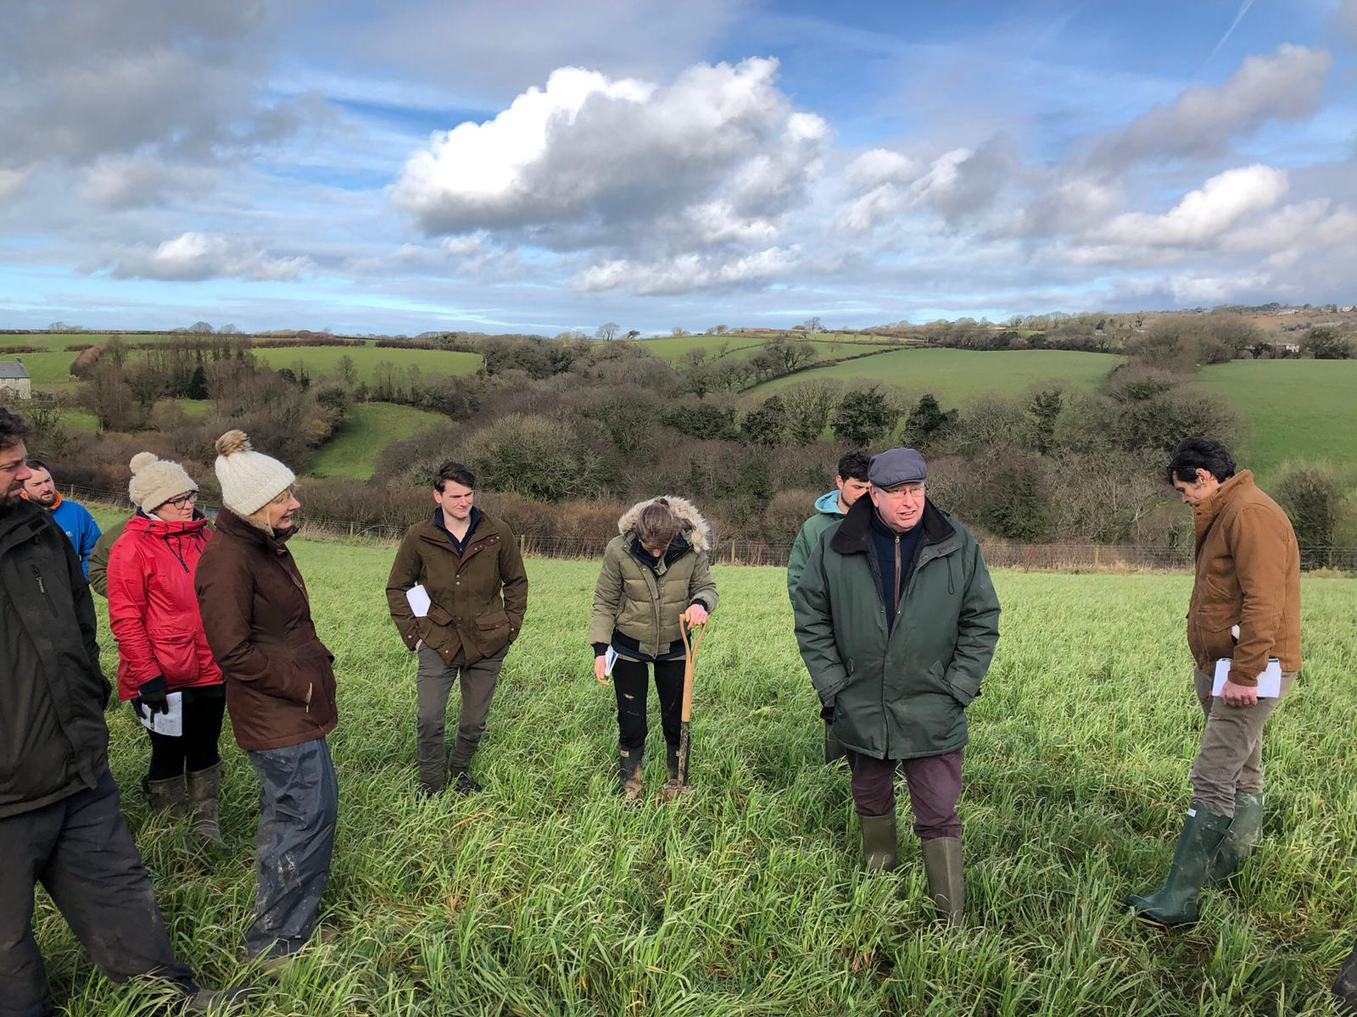
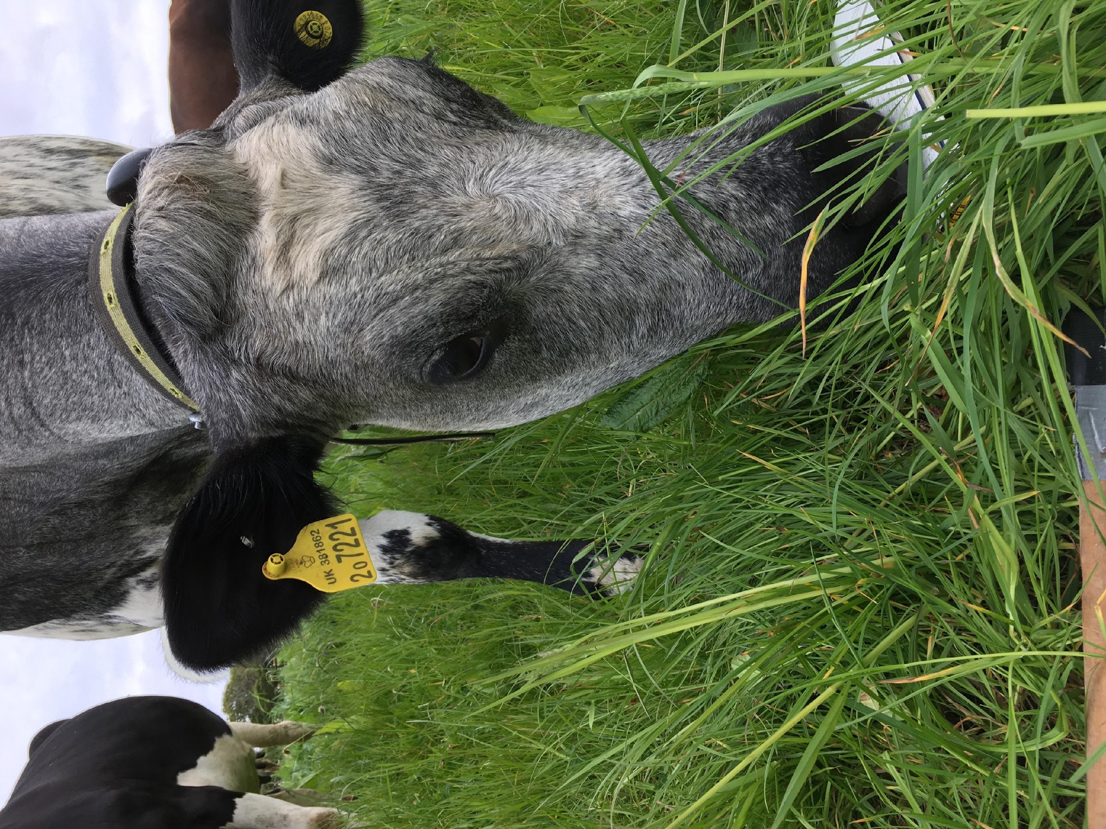
The National Lottery’s Climate Action Fund
“Climate change is everyone’s business”
Farm Net Zero is the first Lottery project that has recognized the Farming Community

Slide 6
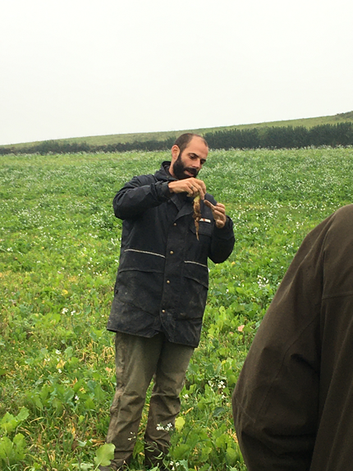
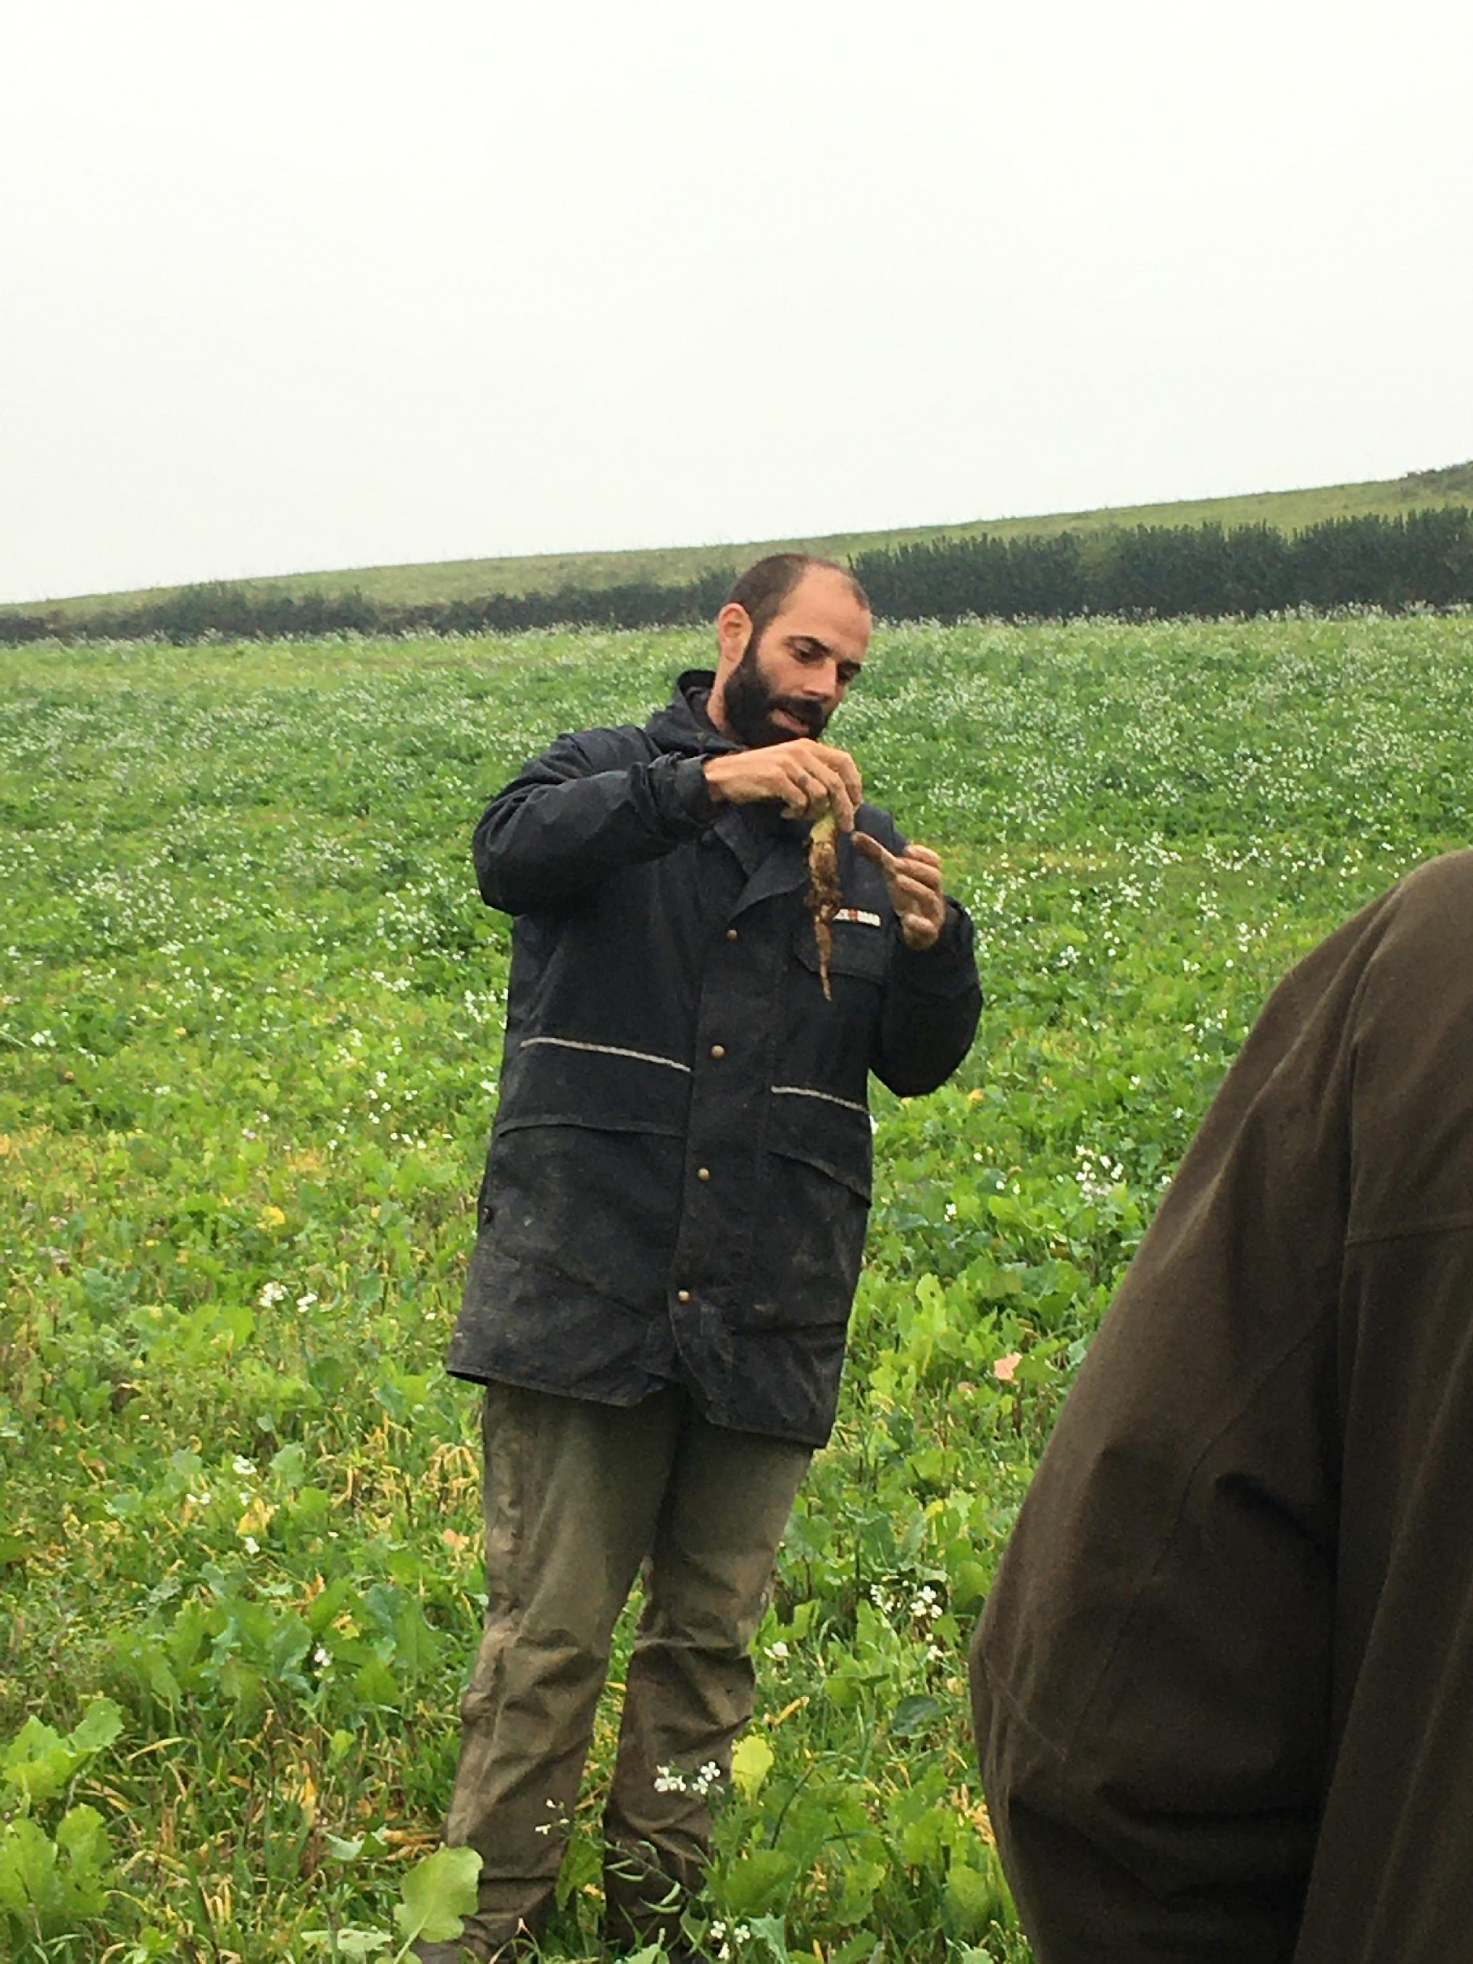
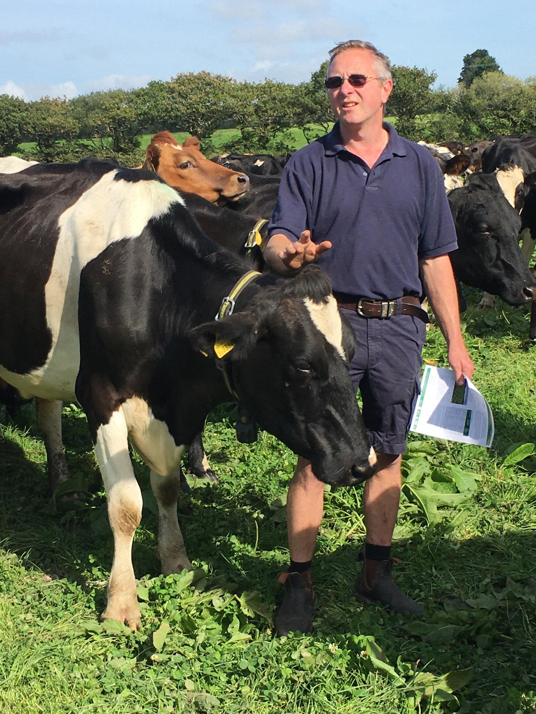
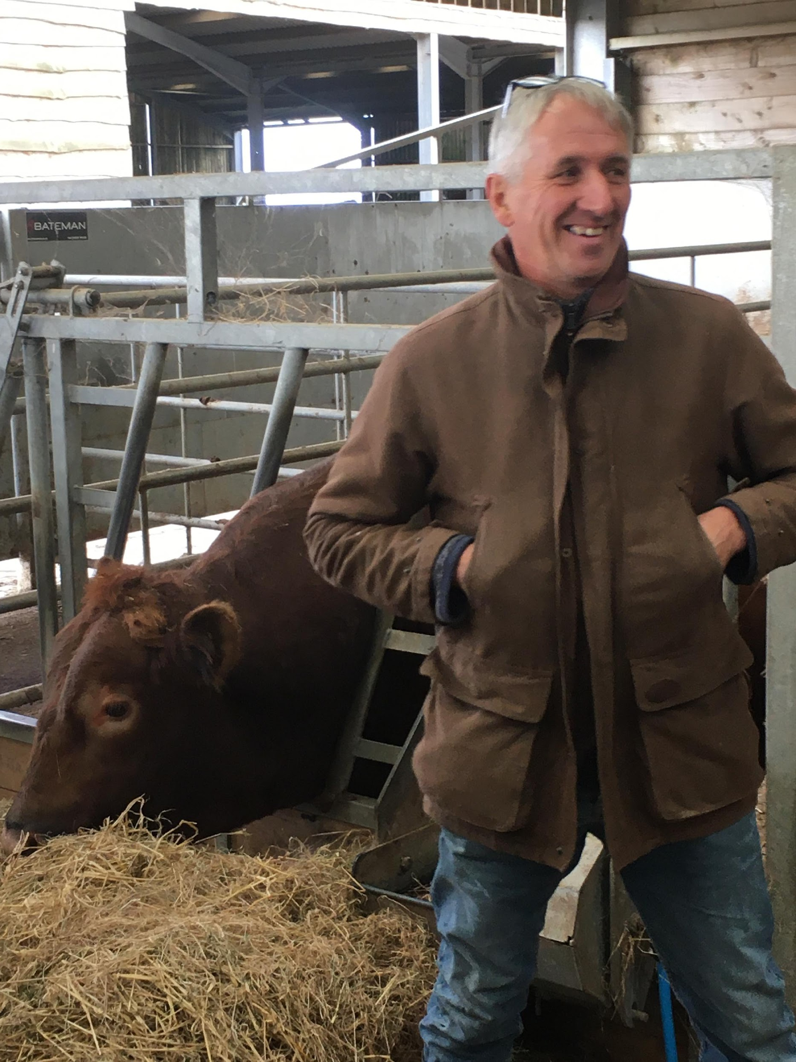
Knowledge sharing

Slide 7
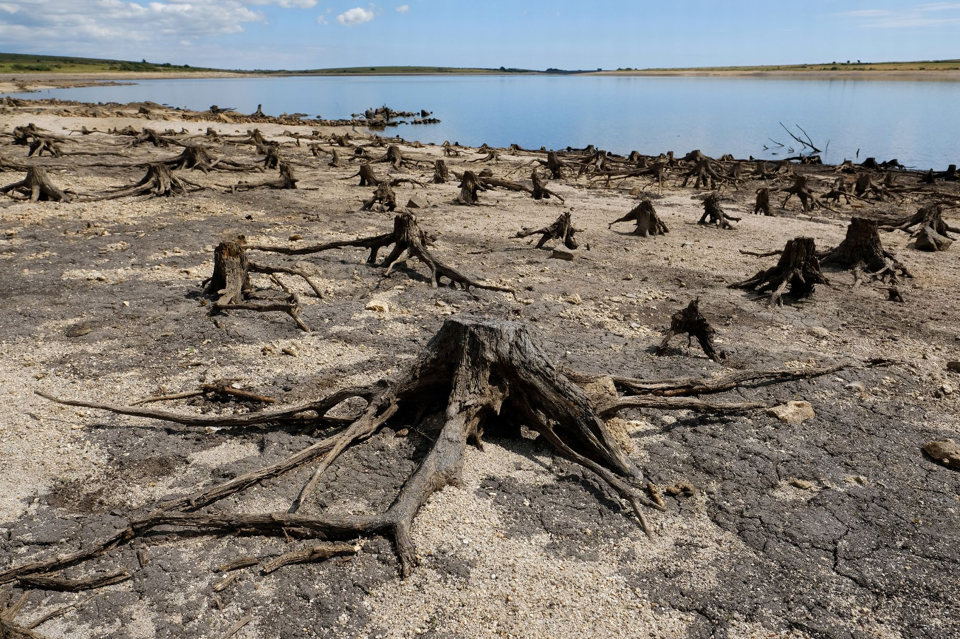
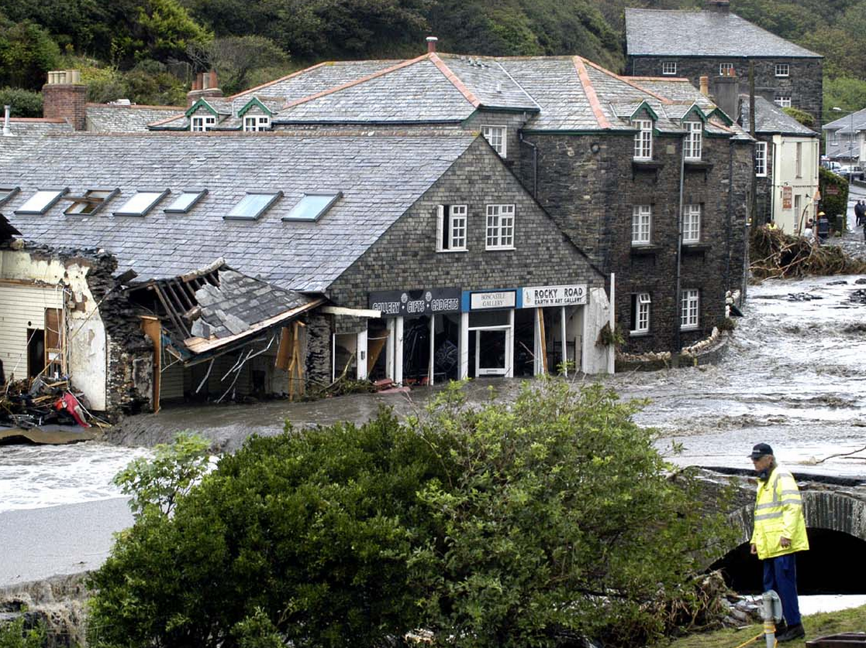
Why?
Reduction in carbon footprint increases farmers resilience
Withstand climatic and economic stresses
Recover rapidly

Slide 8
The simple equation
Atmosphere
Fossil fuels
Photosynthesis
Soil

Slide 9
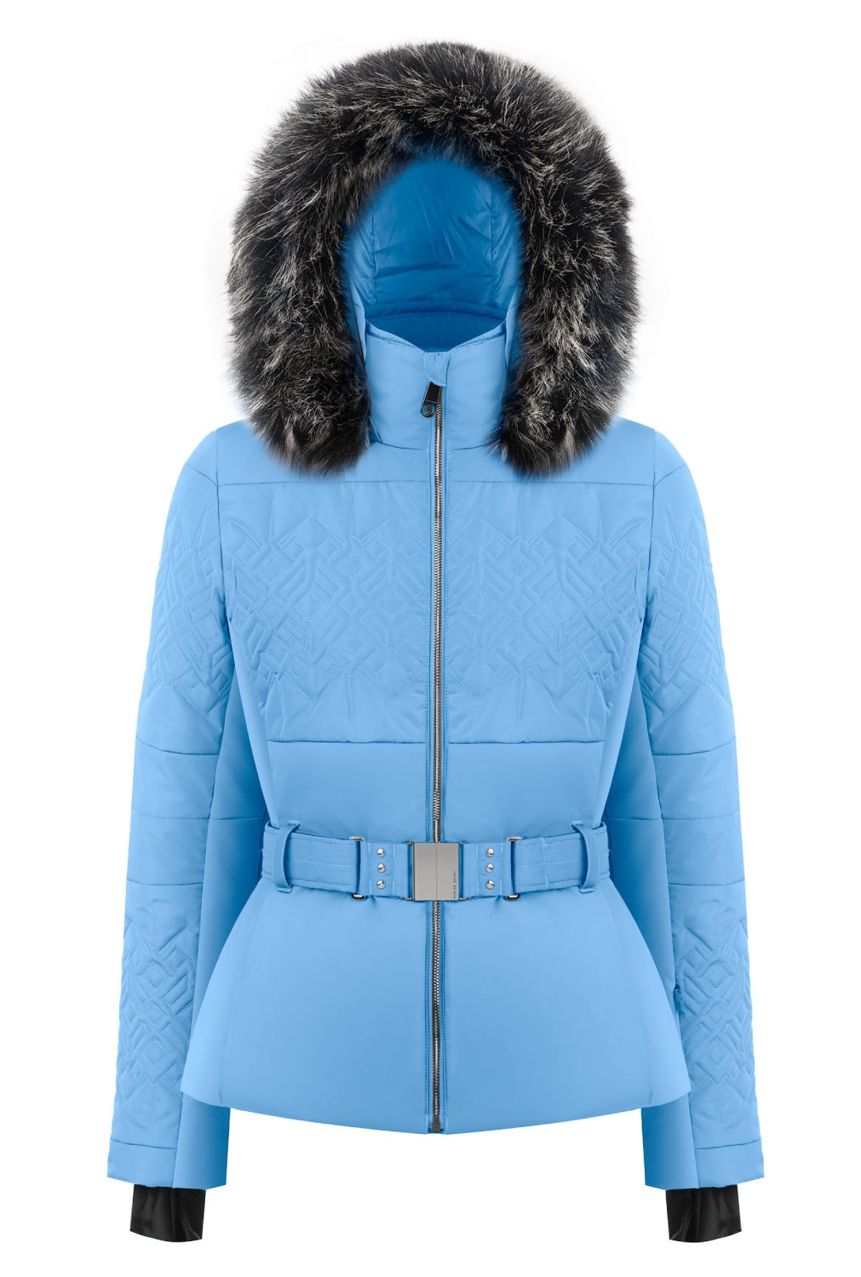
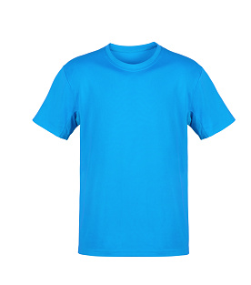
Global warming potential of different gases
Carbon dioxide
Methane
Nitrous
oxide

Slide 10
Global Warming Potential
United Nations Climate Change IPCC Second Assessment Report

Slide 11
Tonnes of carbon dioxide equivalent - tCO2e
For the same gas volume
~310 unit volumes of carbon dioxide = 1 unit volume of nitrous gas

Slide 12
Linking the numbers to on-farm practice
How do you balance sustainability and profitability with a smaller carbon footprint?
Where are the opportunities to reduce emissions as well as improve sequestration?
How does this align with net zero ambitions for the UK, supply chains and our farms?

Slide 13
The four big emitters
Livestock
Feed
Fuel
Fertiliser

Slide 14
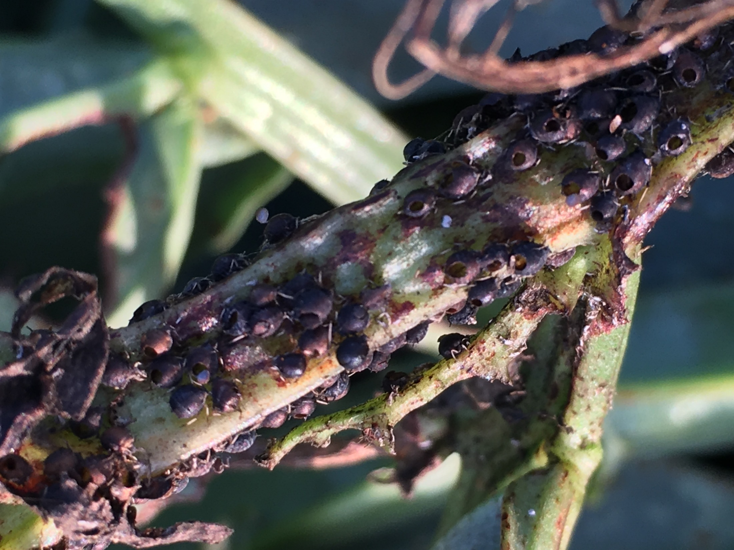

Slide 15
How do we measure change?

Slide 16
The Farm Carbon Calculator

Slide 17
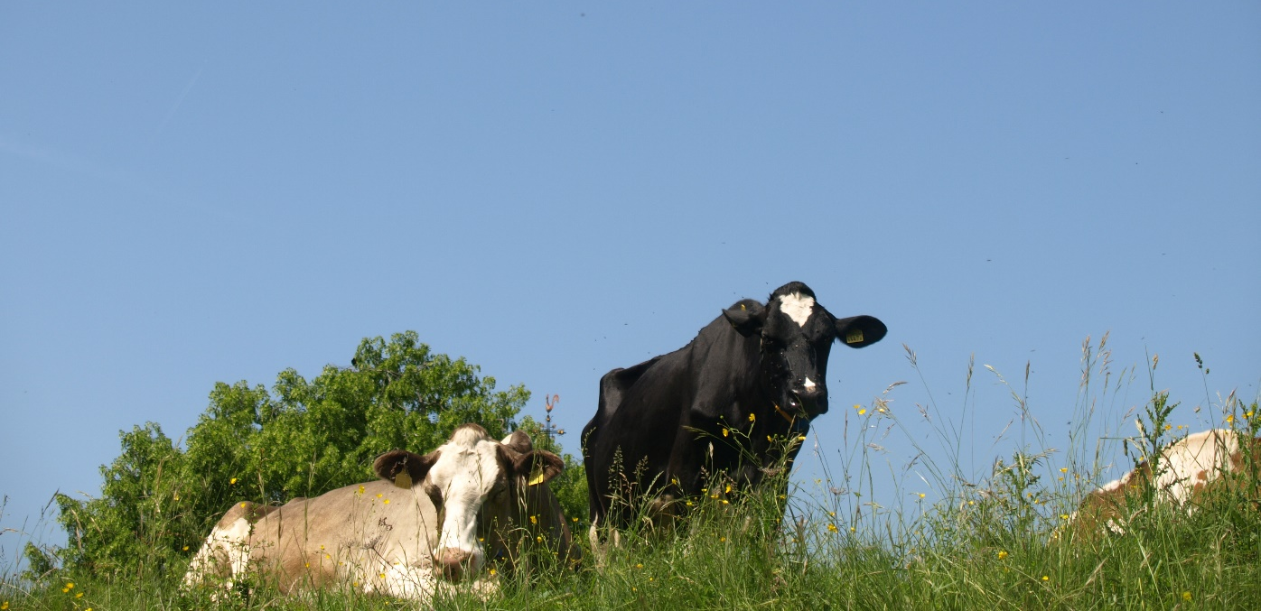
How carbon calculations work

Slide 18
How to offset emissions
10 dairy cows = 50.55tCO2e emitting
Can be offset by:
10km of large growth hedge (2.5m wide) = 56.20 tCO2e sequestering
2.5 ha of grassland (1% increase in SOM in five years) = 53.06 tCO2e sequestering
7ha of 5-10 year old broadleaf woodland = 54.04 tCO2e sequestering

Slide 19
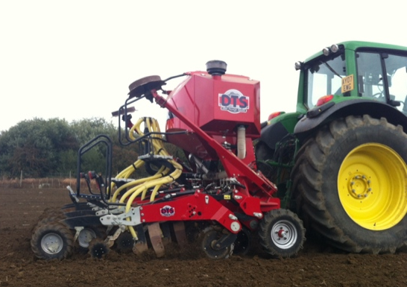
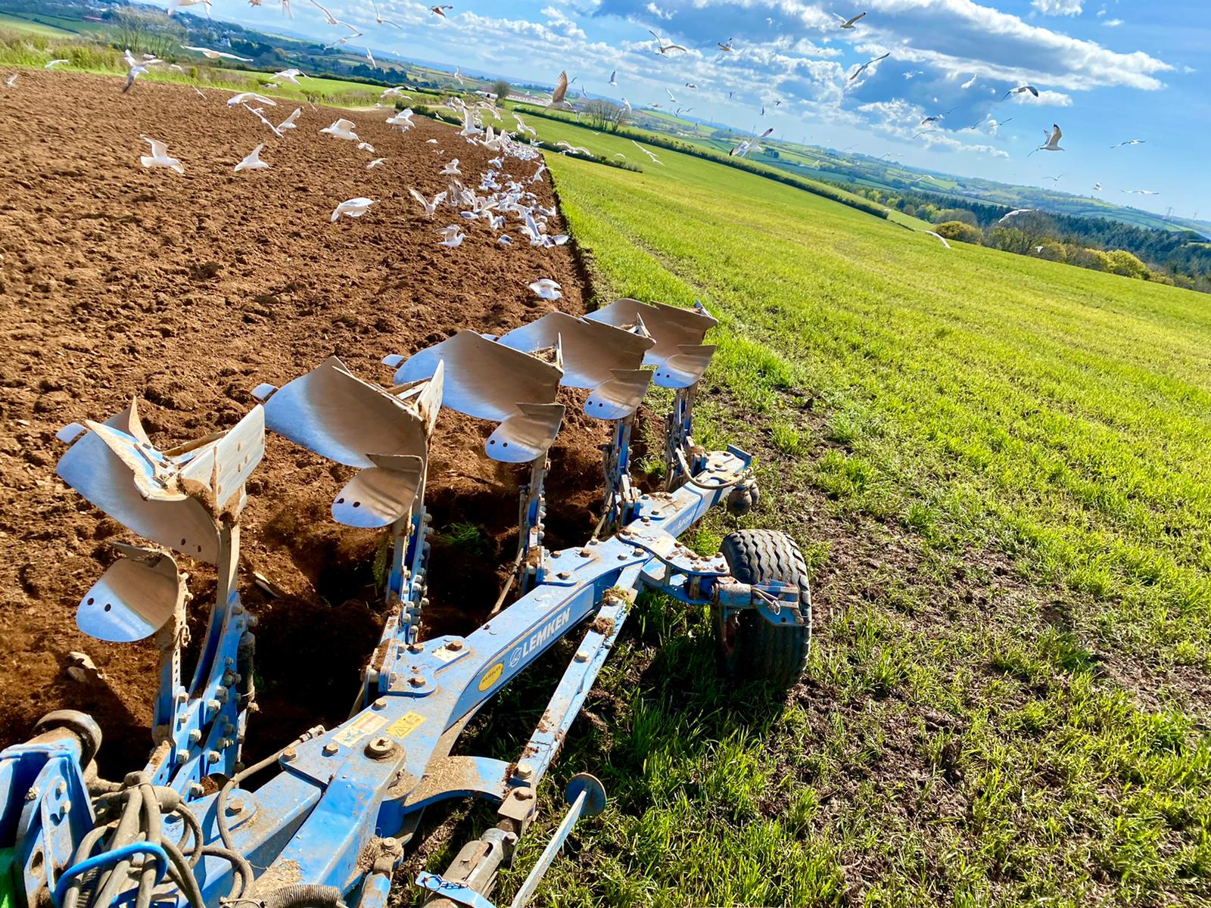
Maize
Improvement

Slide 20
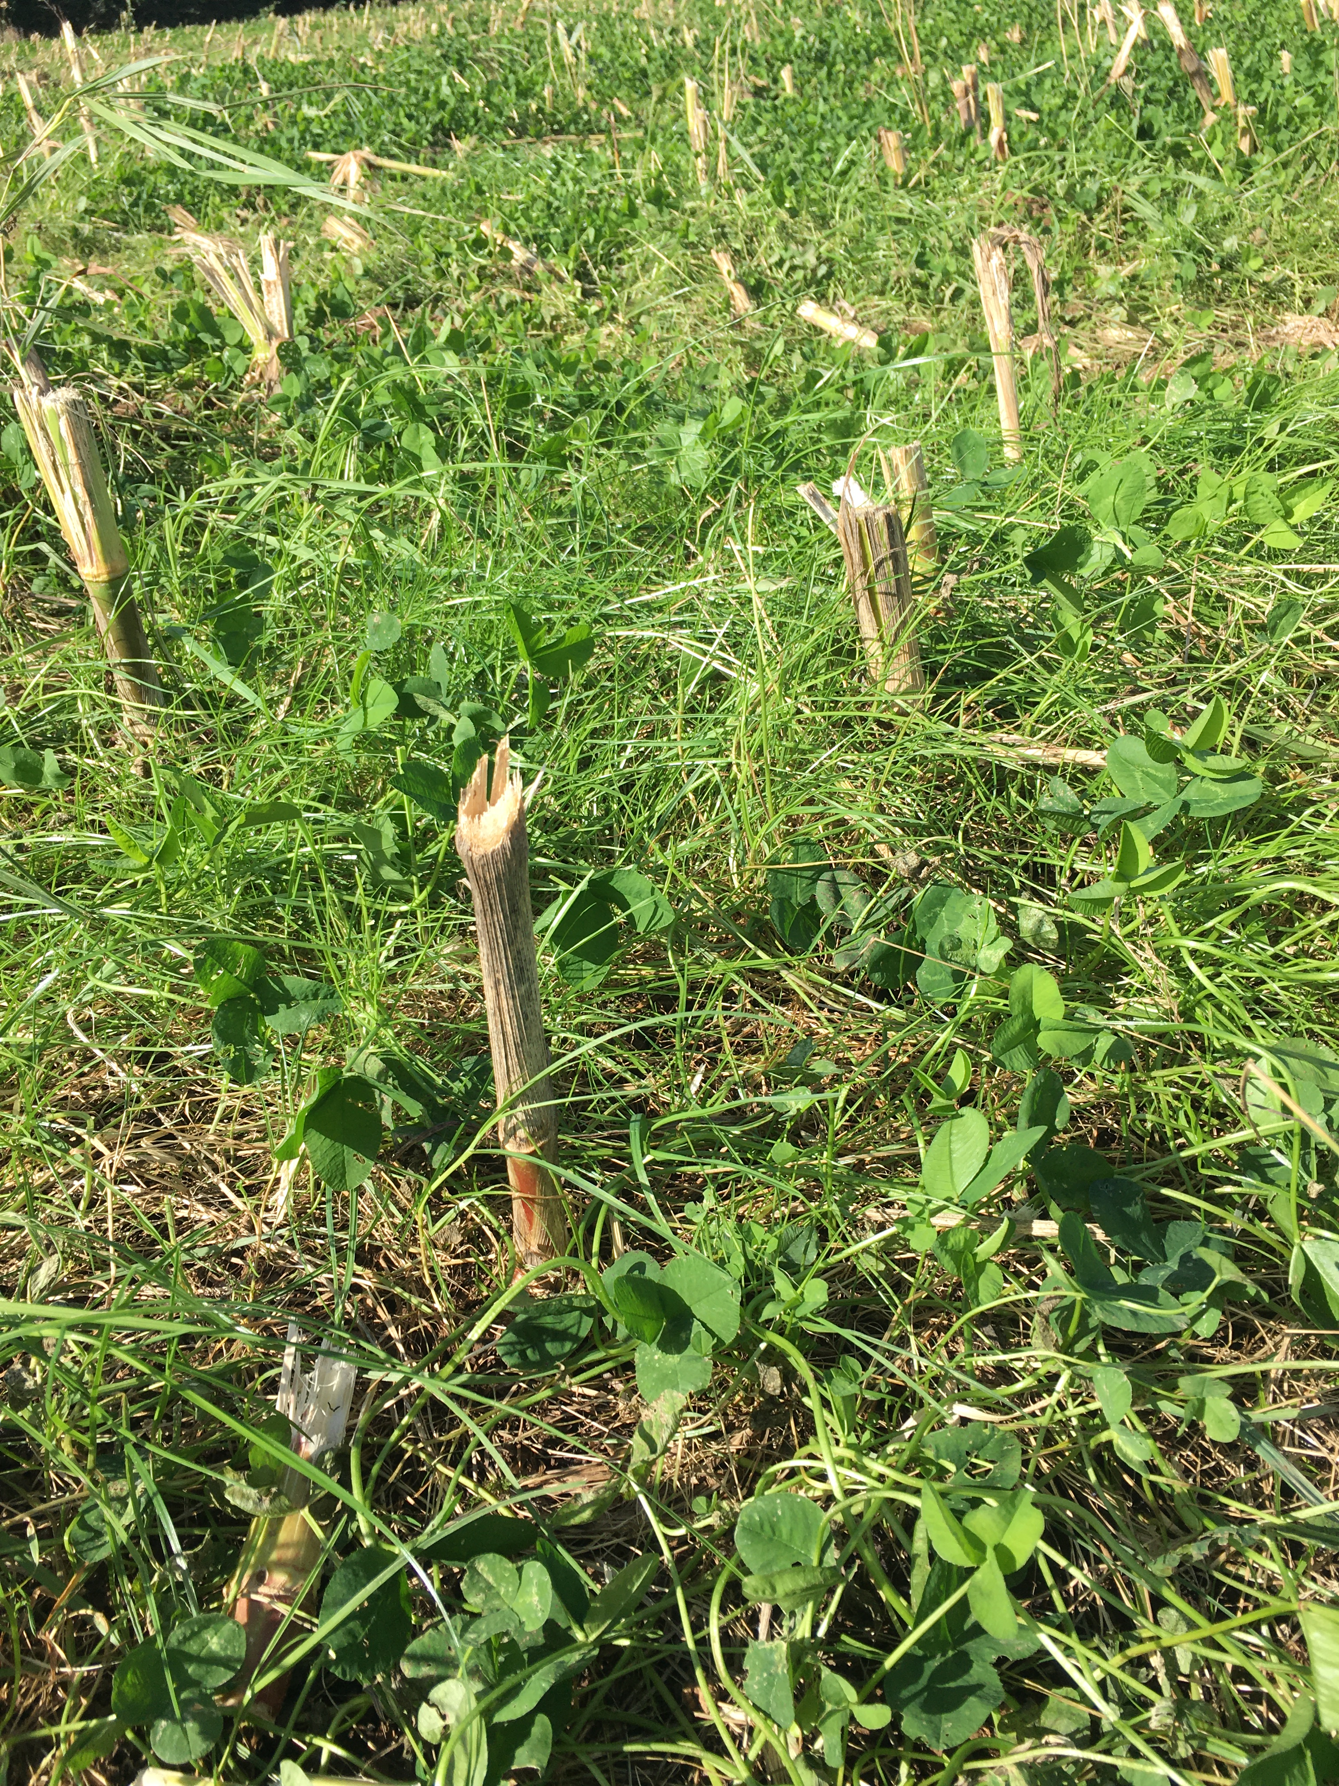
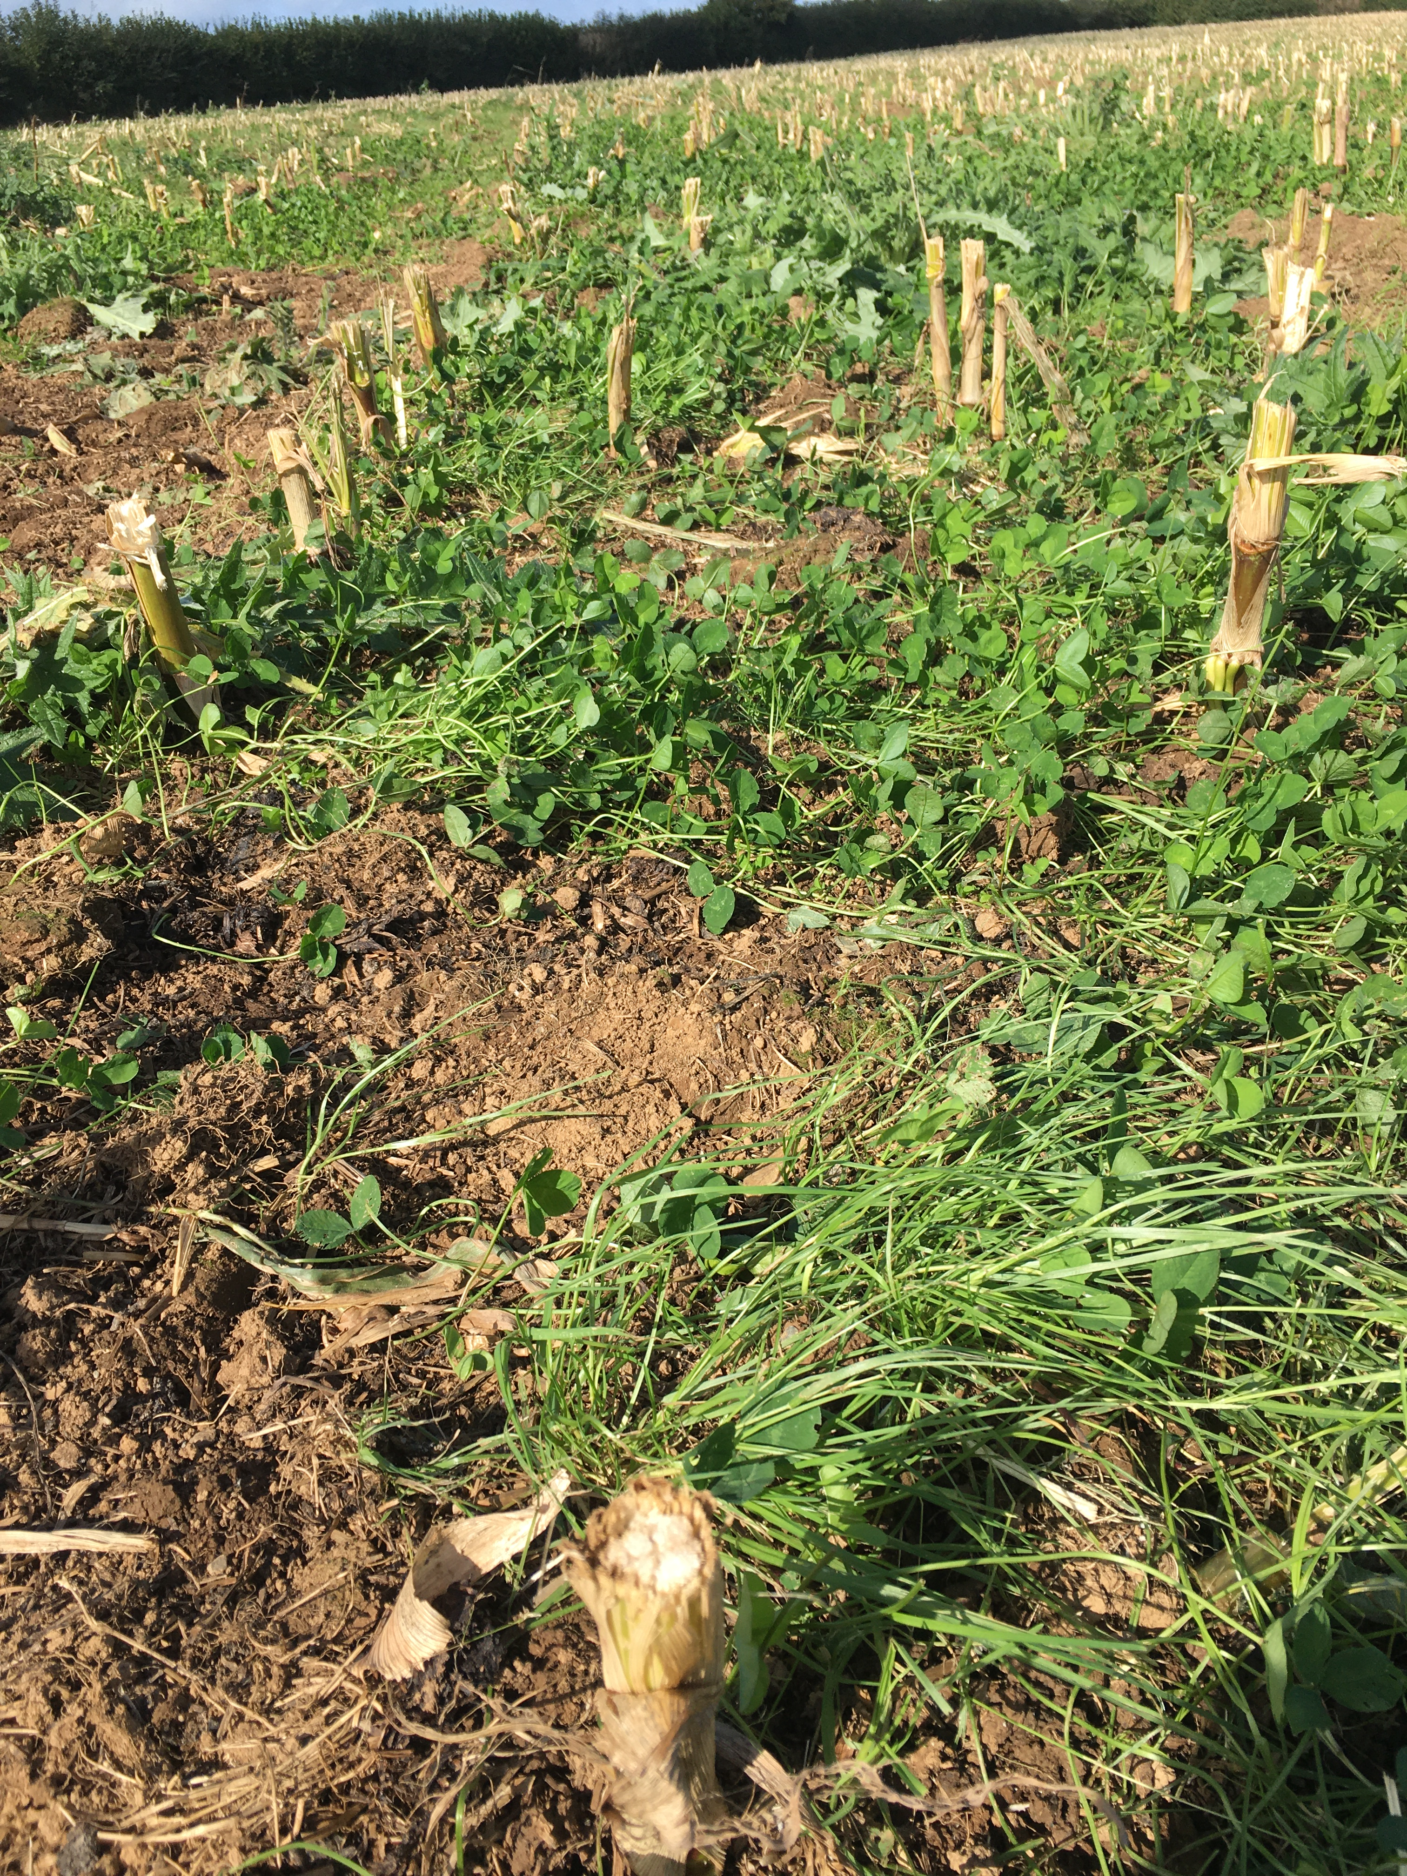
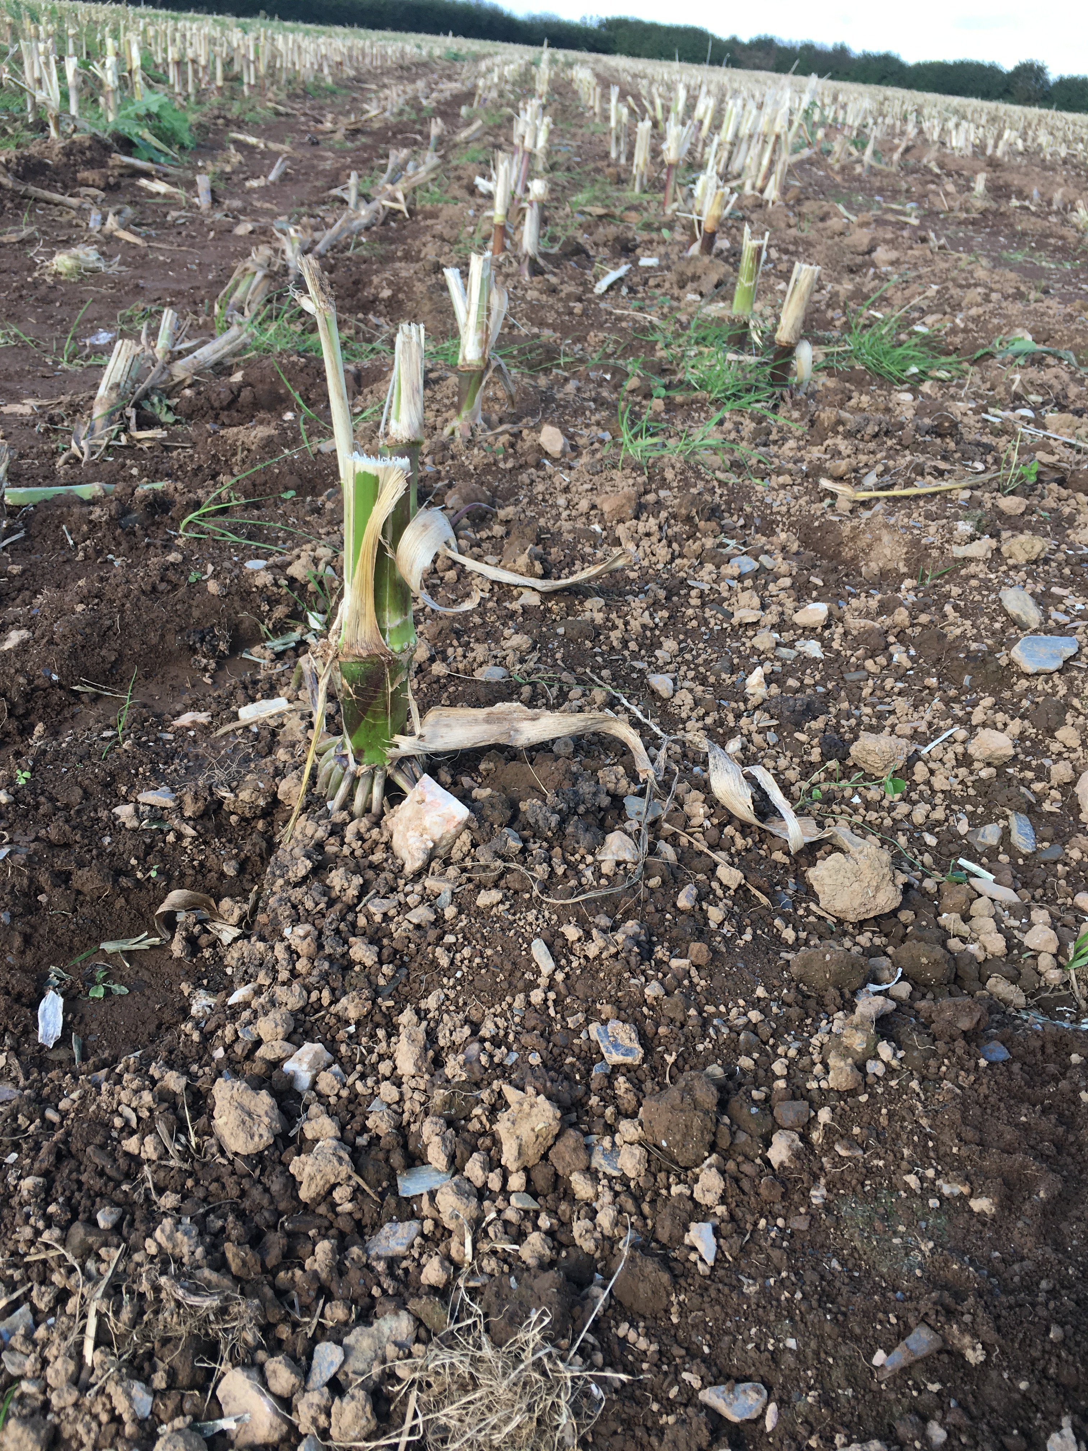
The under storey…
Saves of an estimated 60 tCO2e

Slide 21
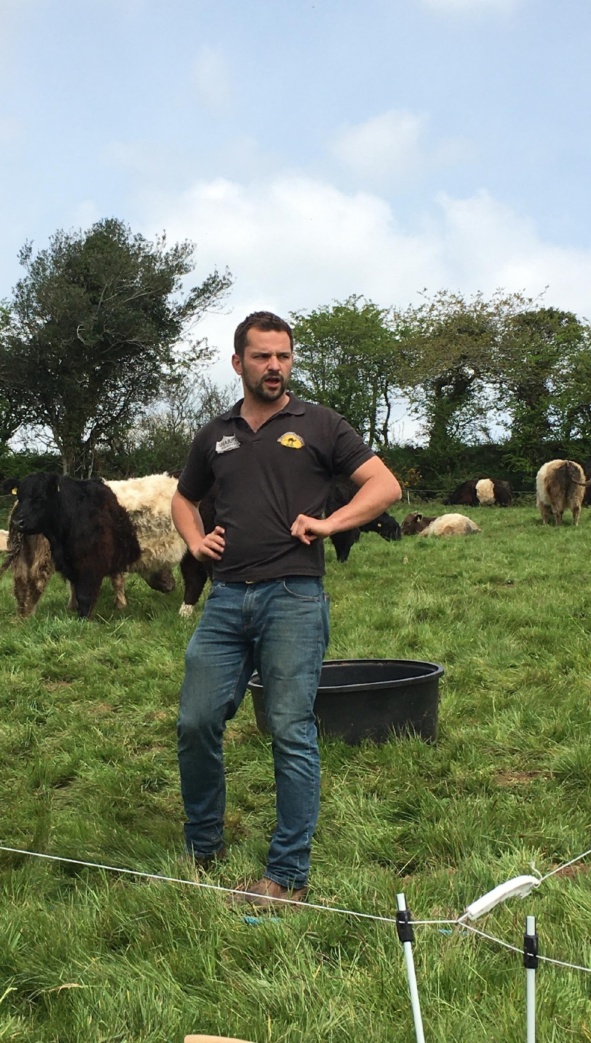
Grasslands to support biodiversity
Low inputs
Select breed of cow to graze scrub and rough pasture
Tree ‘browsing’ for cattle welfare and habitat management
Optimal grazing system

Slide 22
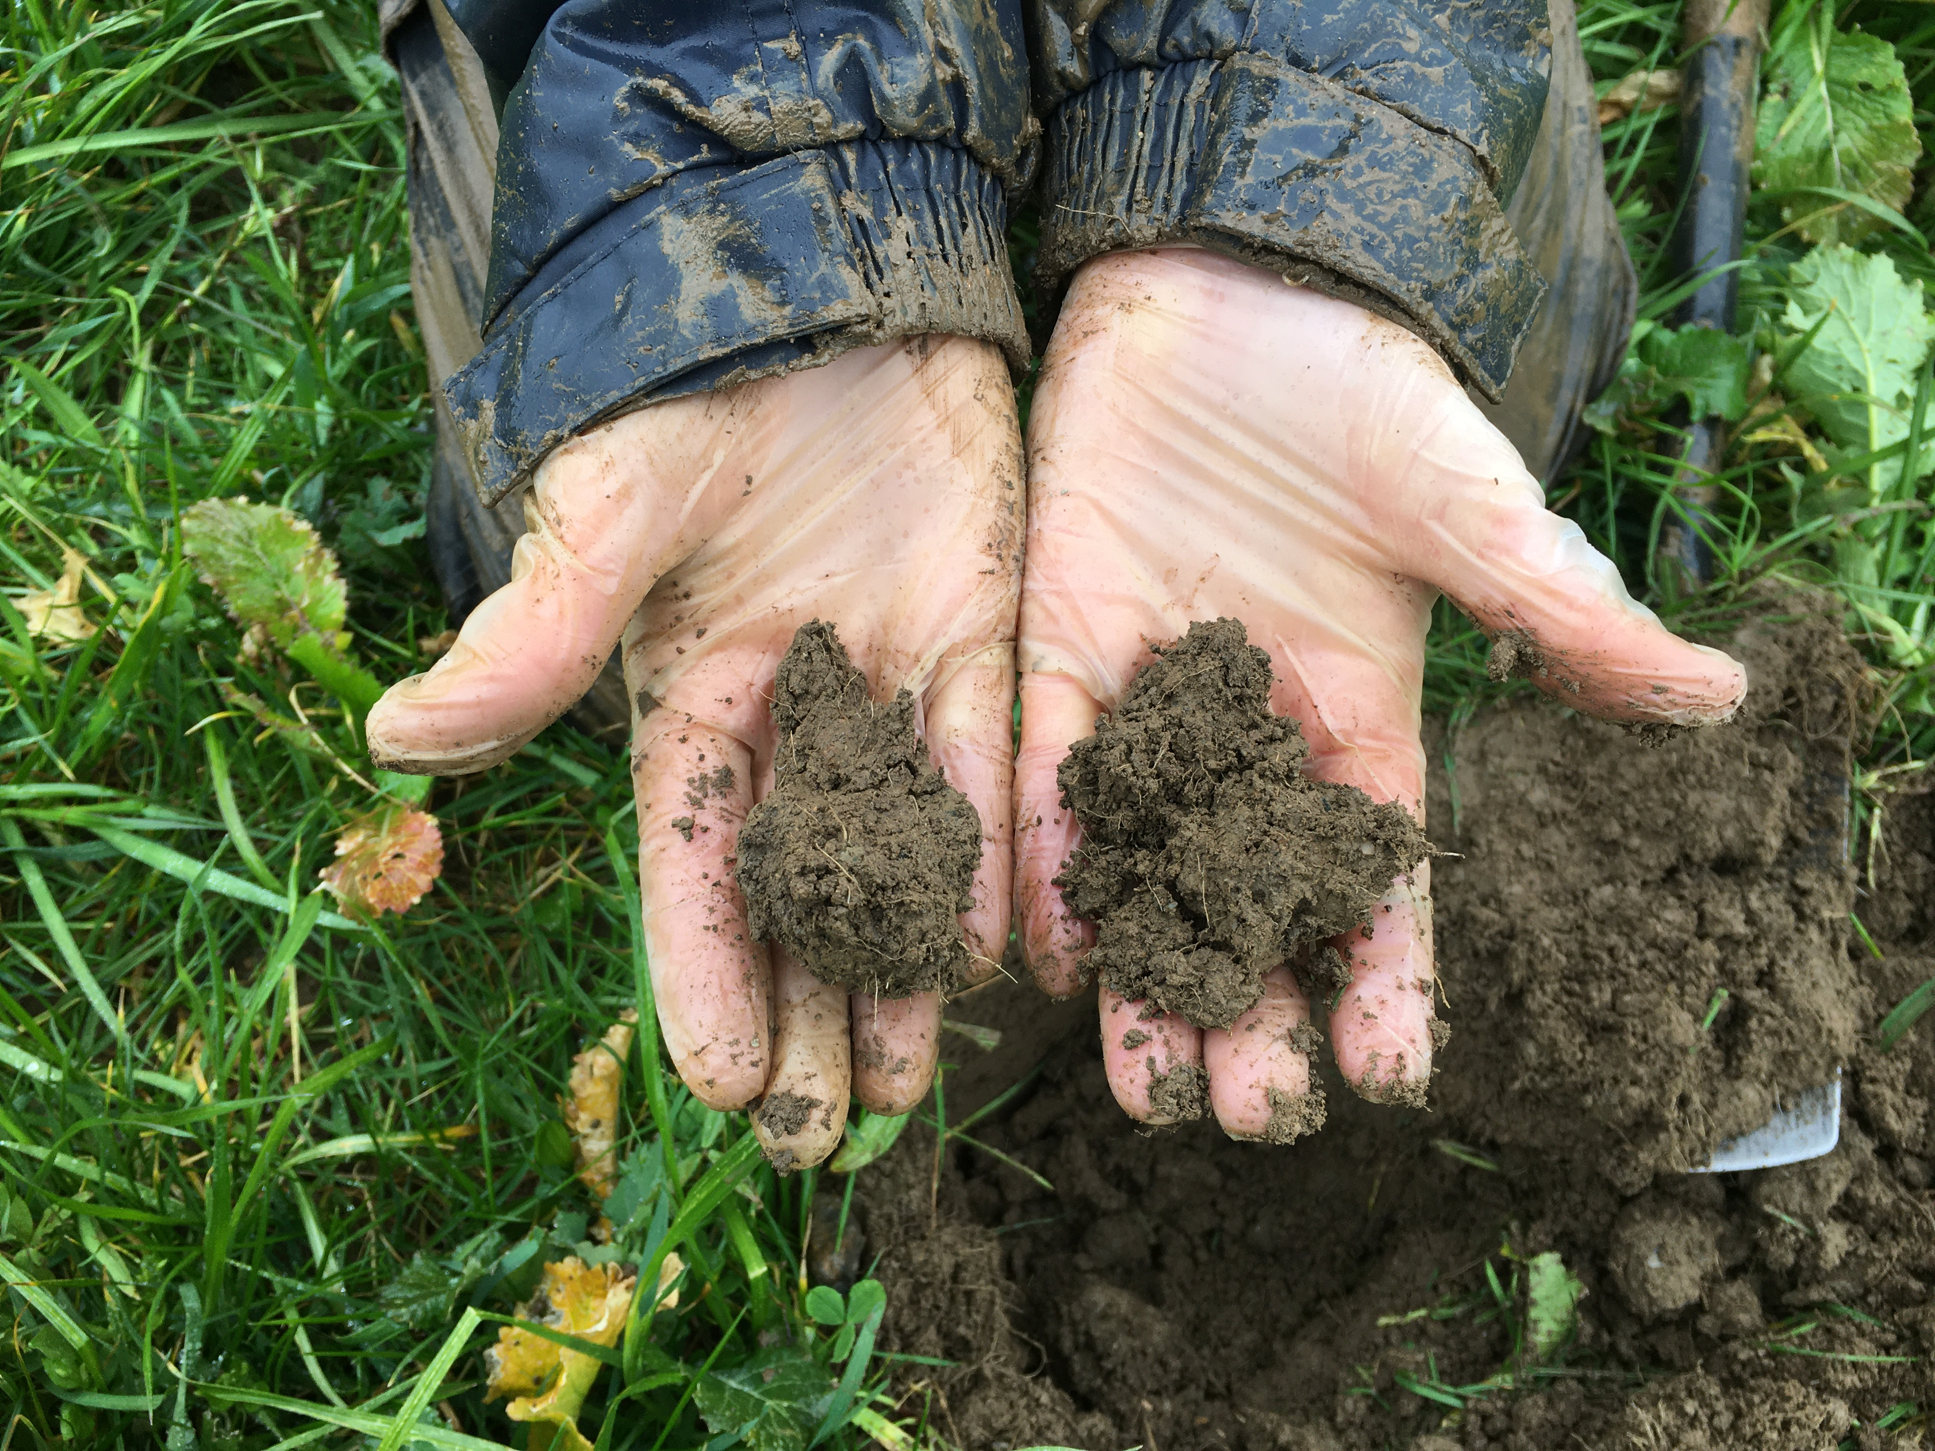
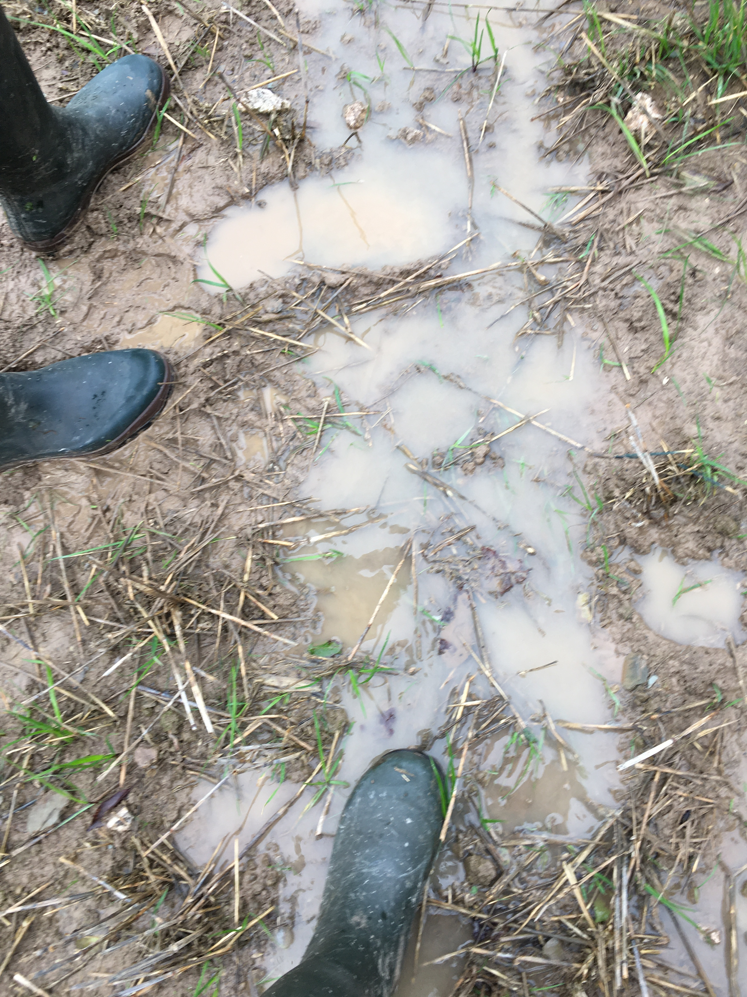

Slide 23
Soil stability
Increasingly unstable
Scores 0 1 to 2 3 to 4

Slide 24
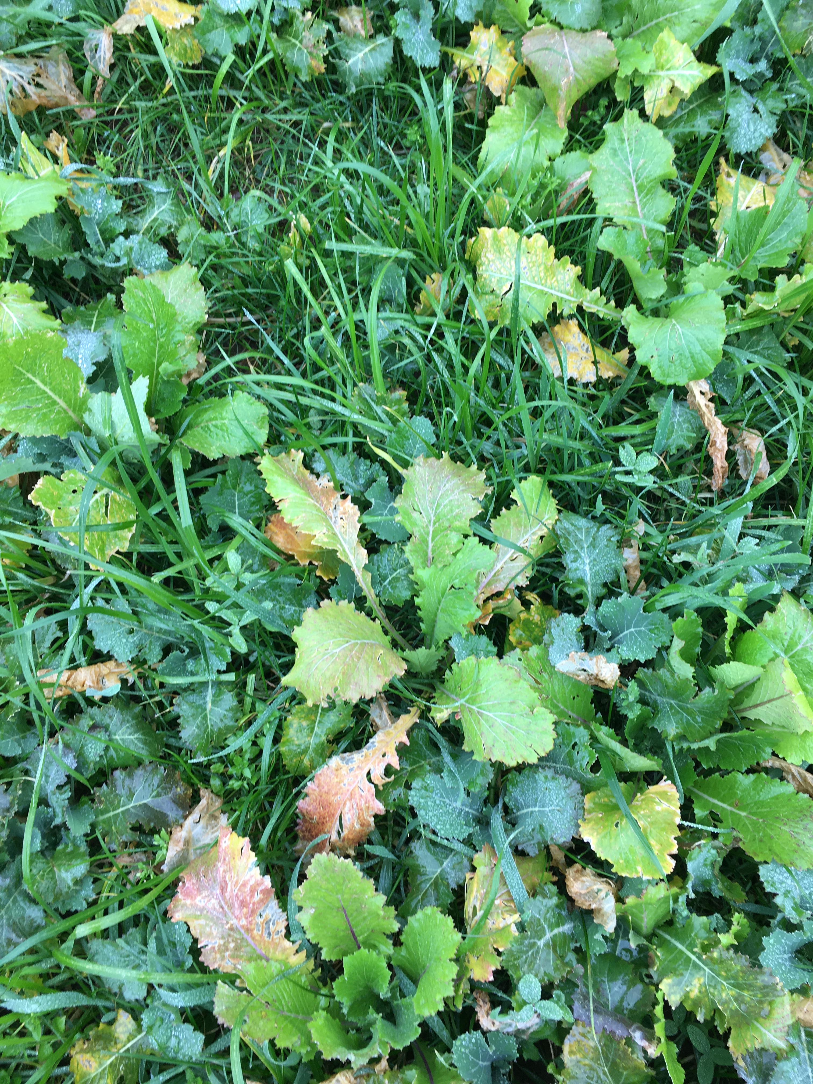
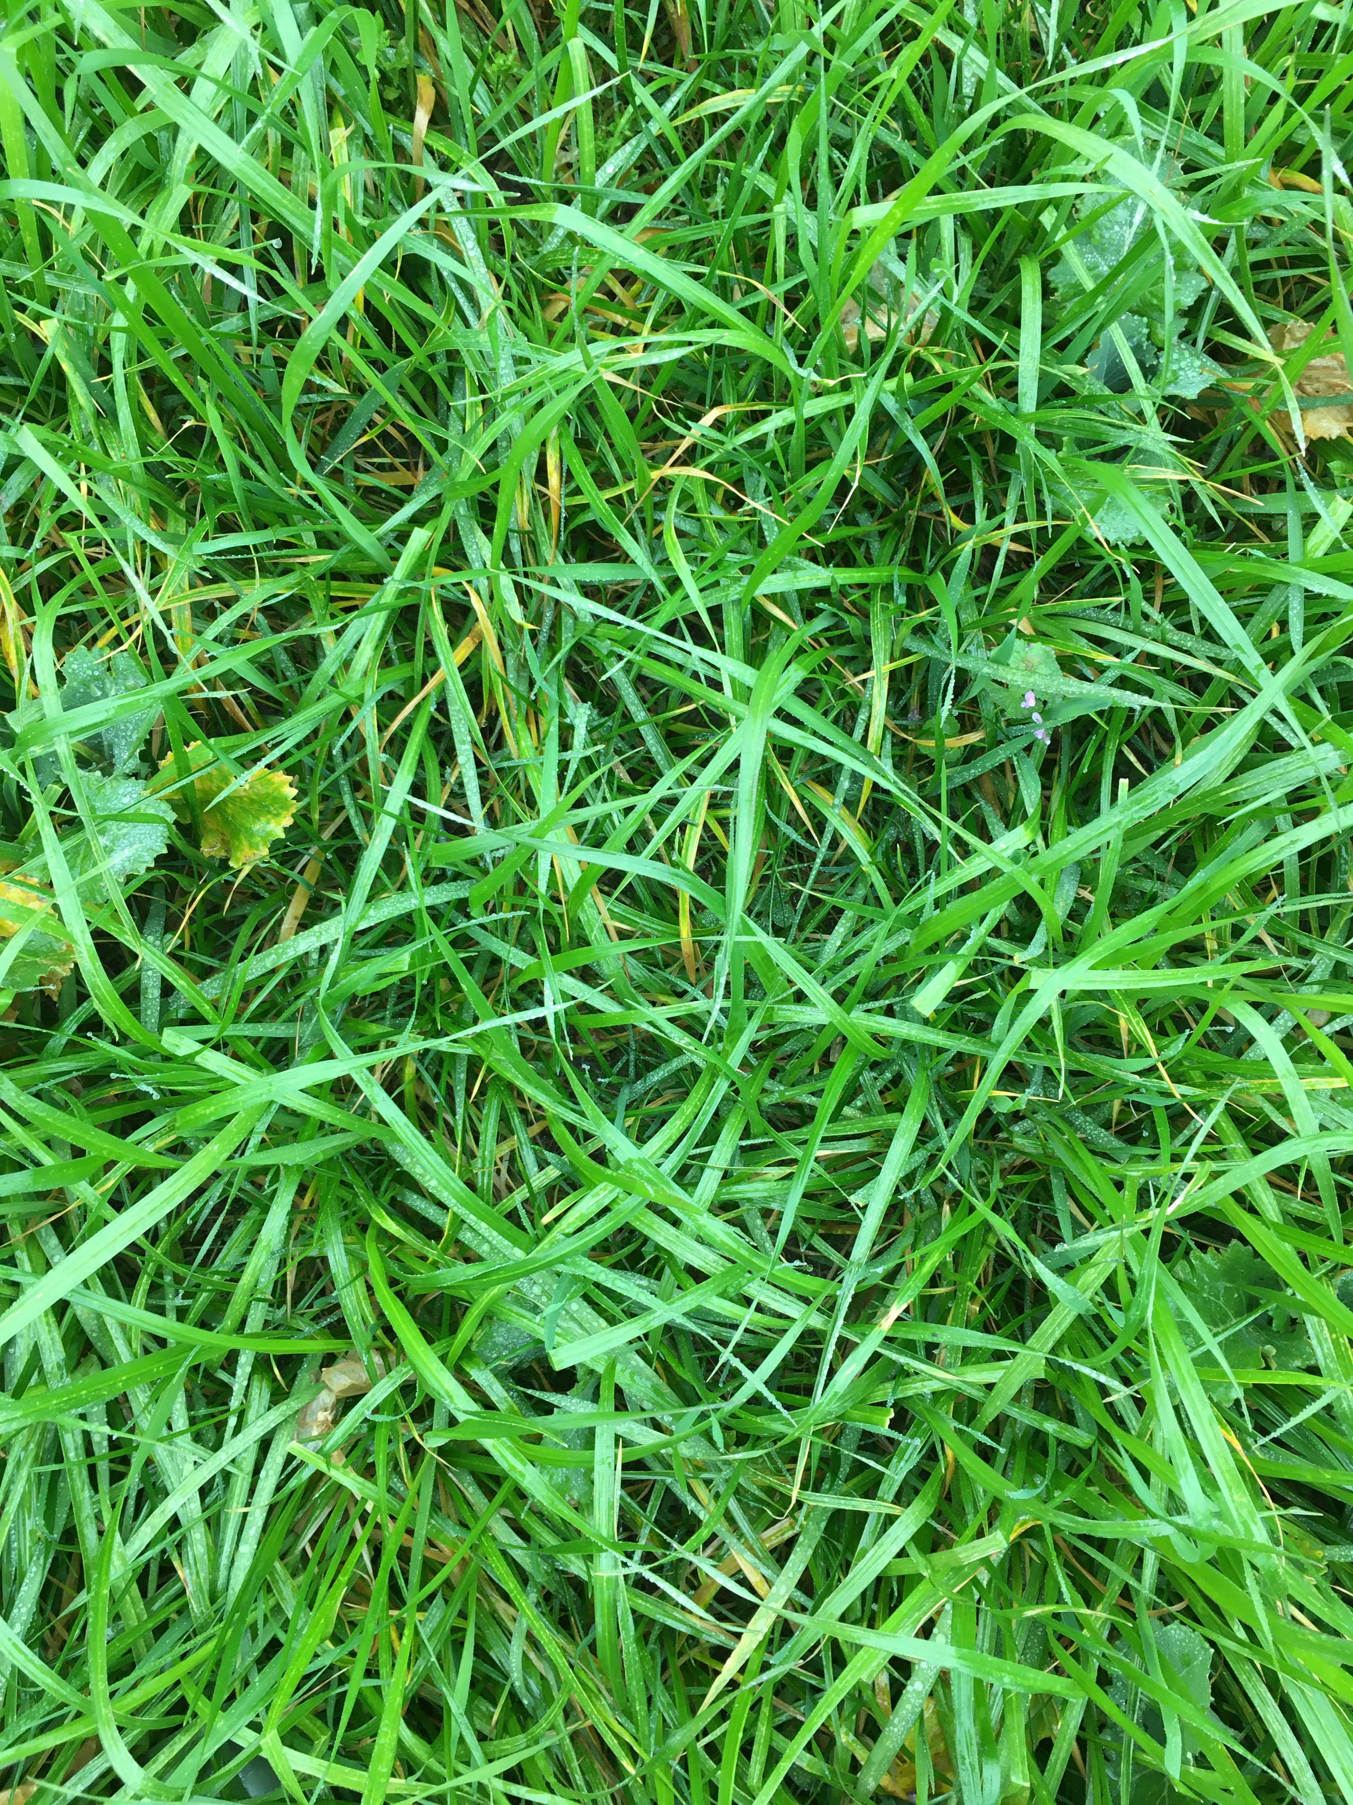
+ stable soil
+ captured nutrients
+ increase in soil carbon
+ better soil structure

Slide 25
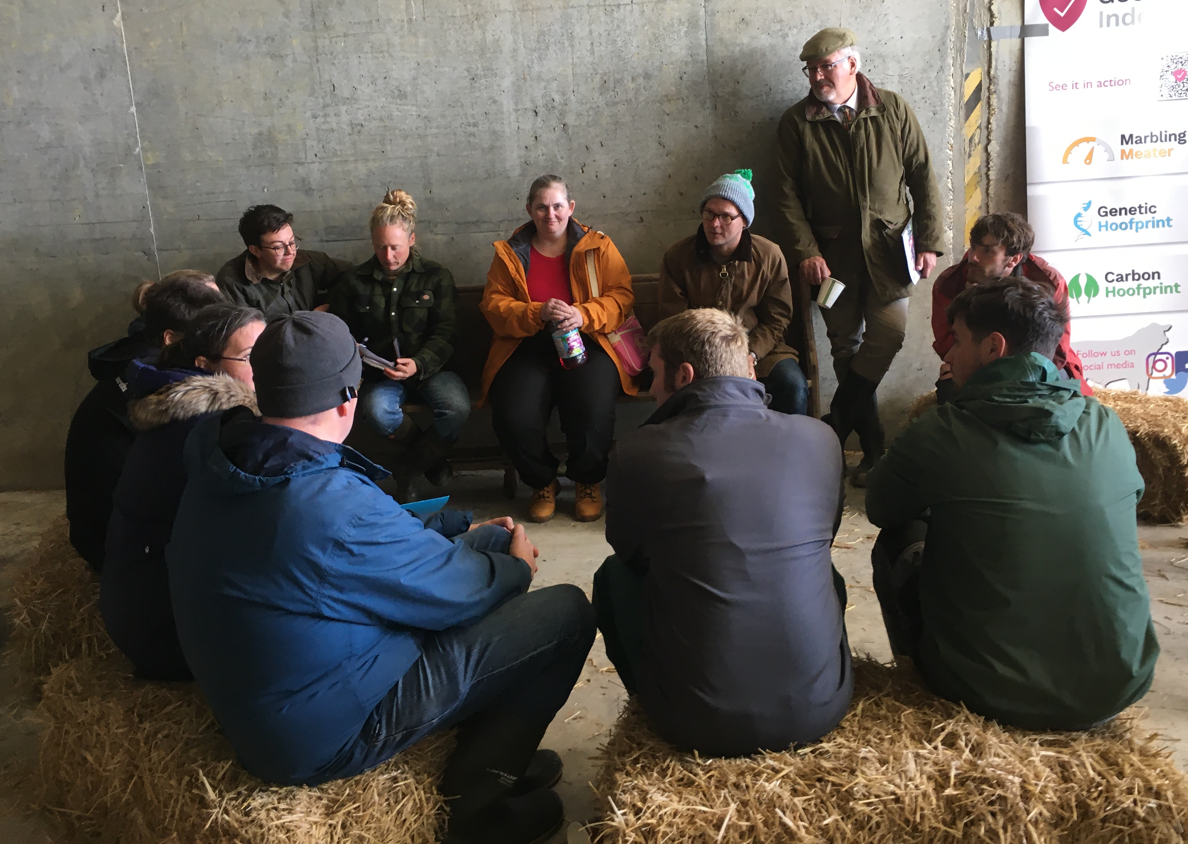
Community networks and benchmarking

Slide 26
The basic rules of soil health
Keep the soil covered
Optimise species diversity
Minimise soil disturbance
Integrate livestock where possible

Slide 27
How can you help?
Know where your food comes from
Support growers and farmers who are making an impact
Take responsibility for your own carbon emissions AND sequestration

Slide 28
Communication

Slide 29
Thank you
Providing evidence, empowering farms, inspiring change
Lottery Climate Action Fund

Slide 30
Electricity | 11200kWh | 798kg carbon dioxide equivalent
Heating oil | 2000 litres | 6136kg carbon dioxide equivalent
Petrol | 10,000 litres, 45miles/gallon | 2676 kg carbon dioxide equivalent
Diesel | 10,000 litres, 50 miles/gallon | 57 kg carbon dioxide equivalent
Total emissions |  | 9,667 Kg carbon dioxide equivalent
Lawn | 65 square metres assume 0.1% increase in SOM in 5 years | 20 kg carbon dioxide equivalent
Flower beds (very shrubby) | 100 square metres assume 0.5% increase in SOM in 5 years | 90 kg carbon dioxide equivalent
Allotment | 375 square metres assume 0.5% increase in SOM in 5 years (heavier soil) | 3590 kg carbon dioxide equivalent
Hedgerow | 25m large growth 2 m width | 110 kg carbon dioxide equivalent
Trees | 6 Broadleaf (beech) | 1000 kg carbon dioxide equivalent
Young trees | 4 willow + 1 oak | 4.4 kg carbon dioxide equivalent
Total sequestration |  | 4814 Kg carbon dioxide equivalent

