Slide 1
Built by the community, for the community
Jenny Hindson
Chief Operating Officer

Slide 2
Plants are easy, people are difficult ….but fascinating, resourceful, joyful and powerful
Jenny Hindson
Chief Operating Officer

Slide 3
OUR VISION
For everyone to have access to green community spaces that are good for the community, good for nature and good for the economy
OUR MISSION
We will create the best green community space in the UK.
We will empower our community to evolve Newquay Orchard to meet the needs of people and planet, while creating profit.
We will use Newquay Orchard to demonstrate a replicable and financially sustainable solution for communities across the UK to help them thrive and tackle local issues that are important to them.
Community
Learning
Environment
Integrity
OUR VALUES

Slide 4
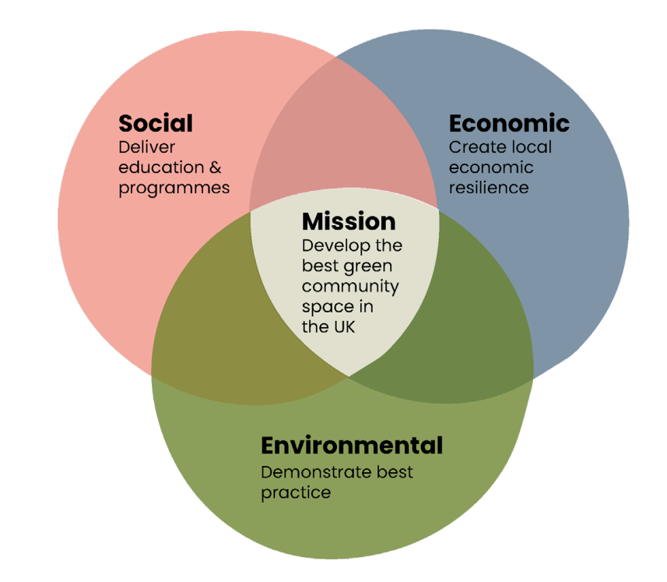
Delivery community learning and wellbeing
How do we join up our thinking for maximum impact across the system…for one and all?

Slide 5
Very good for one and all….

