Slide 1
Sustainable School Food Landscape for Cornwall Fatma Sabet

Slide 2
The UK is one of the most nature depleted countries in the world, and Cornwall is no exception
75% of Cornwall is farmed. Without improvement to agricultural management and/or changes in the buying habits of the average consumer, we will see further losses of birds, mammals, butterflies and other insects, (State of Nature Cornwall, 2020)
Increased pesticide use results in significant declines in pollinators and other insects
Other factors: Mechanisation, soil exposure and erosion and intensive livestock production

Slide 3
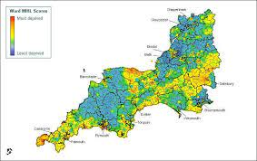
Cornwall has some of the highest areas of deprivation in the UK
9.7 million adults (18% of households) experienced food insecurity in the past month (September 2022)
4 million children live in households that have experienced food insecurity in the past month (September 2022). (The Food Foundation, 2023)
Notes:
2. Add to this the reality of cost of living crisis food insecurity rates in the UK

Slide 4
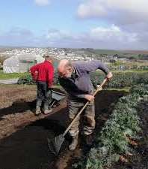
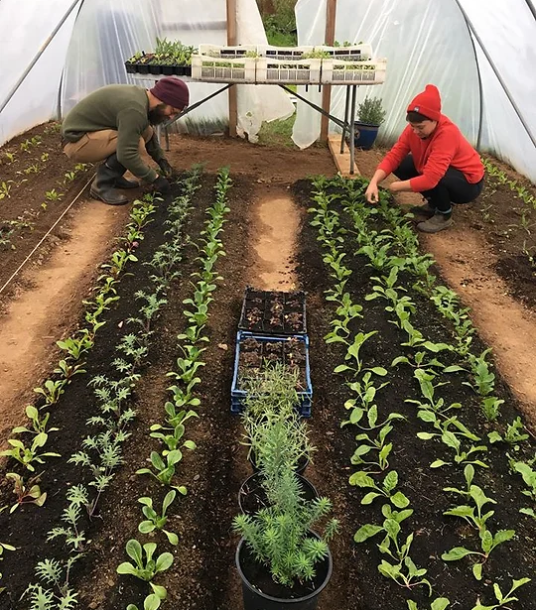
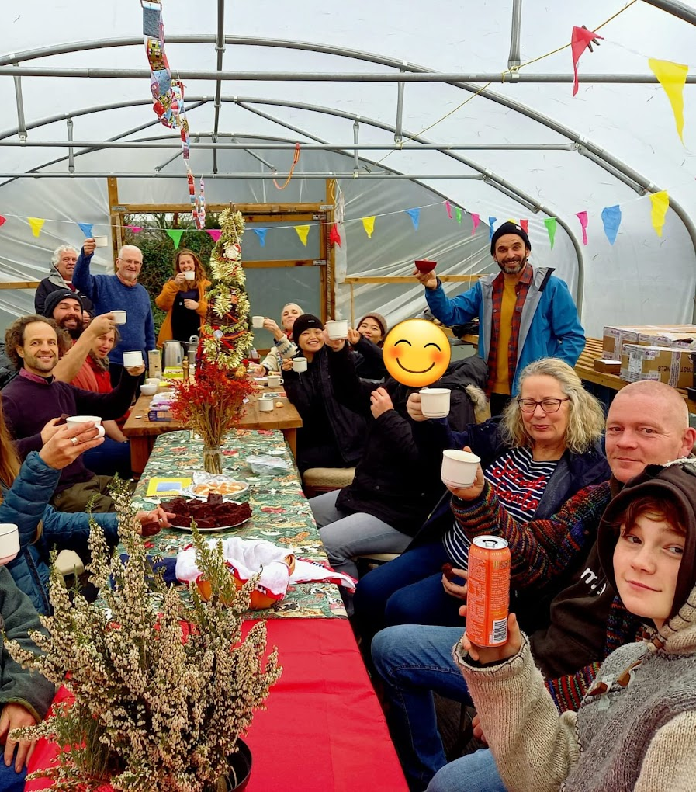
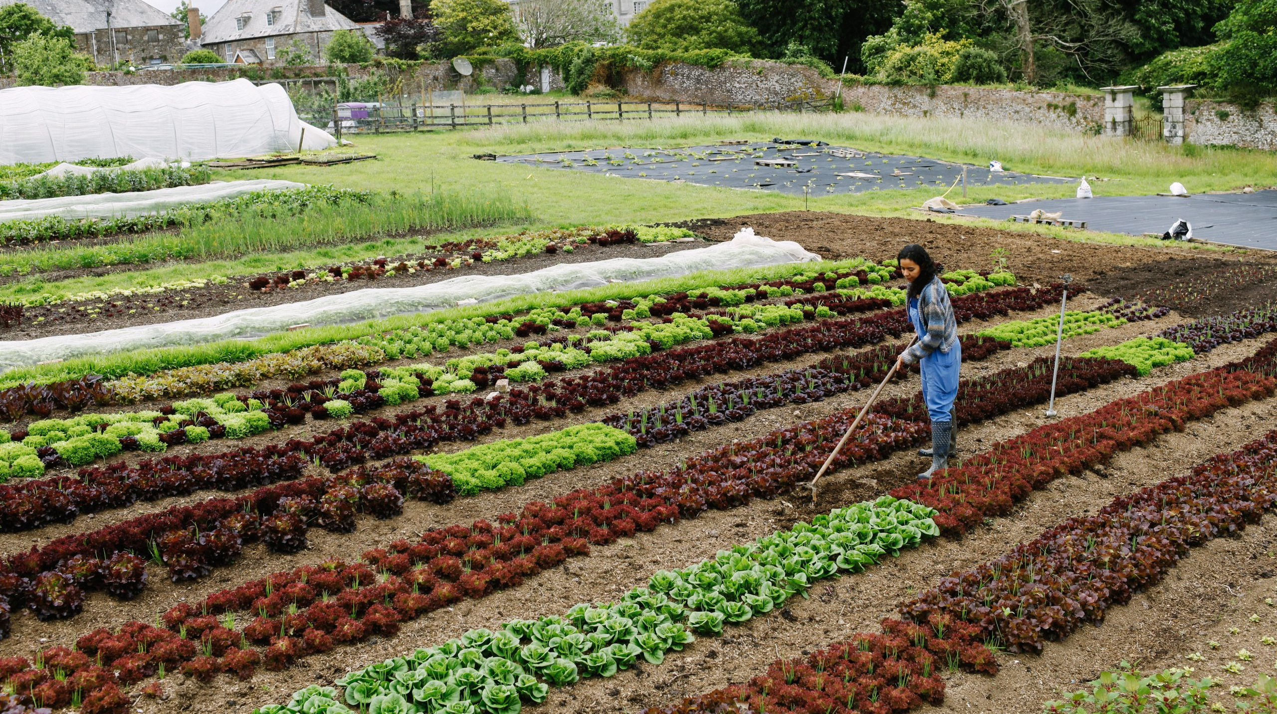
We know that the use of agroecological practices has positive outcomes on food security and nutrition particularly for households with low or middle-income (Kerr et al, 2020).
Notes:
Agroecological practices aim to optimize ecological processes, environmental and public health and well-being, and minimize social-ecological costs from agriculture such as soil degradation, water contamination, greenhouse gas emissions, exhaustion of non renewable resources, and inequitable social structures

Slide 5
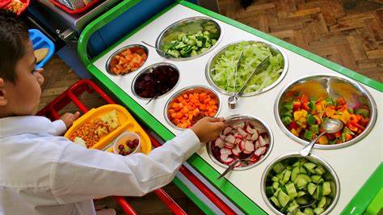
Notes:
But how does school food fit in this context?

Slide 6
School meals are the largest and most widespread social safety net in the world and the UK is not exception with over 22.5% (1.9 million pupils) in June 2022- up from 20.8% in 2021
School catering has the largest share of public procurement in the UK and can contribute to minimizing the impacts of climate change through environmentally sensitive food systems.
The UK government spends an estimated £8,435,000/day on FSM and UIFSM in England
Childhood obesity is the number one threat to children’s health in Britain today.
Childhood obesity
Planetary health
Childhood poverty
Childhood obesity
Planetary health
Childhood poverty
Notes:
Every year the public sector spends over £2 billion providing meals in schools, hospitals, prisons, and many other public bodies. But how is this food sourced, and does it meet the right standards regarding health, the environment and supporting local communities?
An estimate of over £112.000 meals are served in Cornwall’s primary and secondary schools every day with a minimum estimated monetary value of over £263.200. Schools expressed concern over lunchtime meals including uneaten food left on plates, very few ingredients are sourced from Cornish producers and growers and uncertainty over the nutritional value of meals. An innovative platform and framework is urgently needed to support schools, local growers, caterers and pupils to work together to improve all aspects of food in schools.
Three facts
Free school meals: Autumn term, Autumn Term 2020/21 – Explore education statistics – GOV.UK (explore-education-statistics.service.gov.uk)

Slide 7
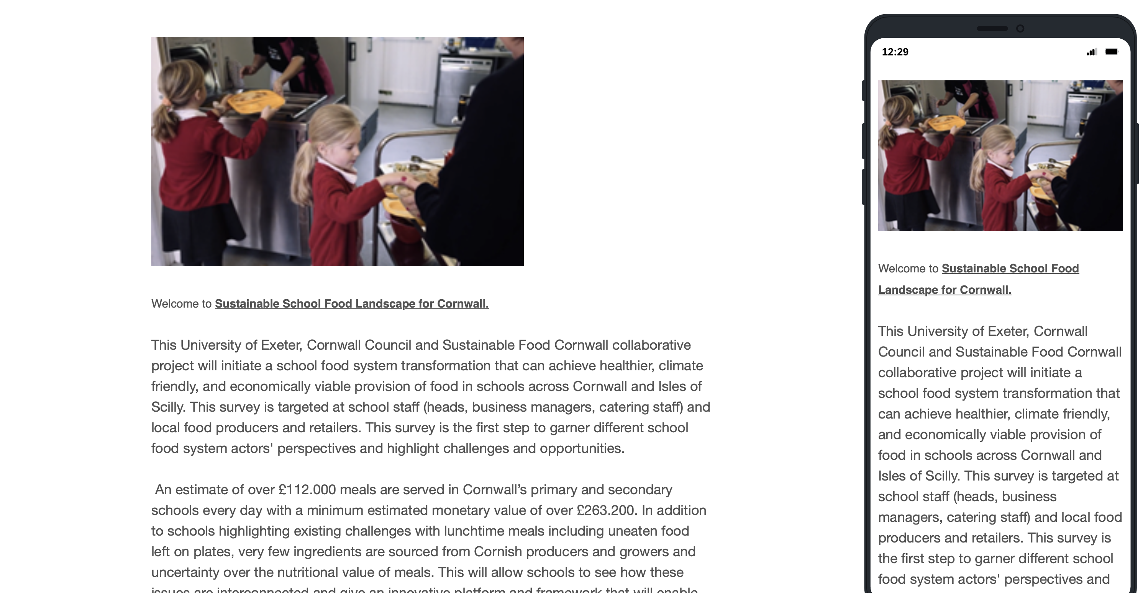
Please help us and fill our survey NOW!
Notes:
Our survey is live!
https://exeterssis.eu.qualtrics.com/jfe/form/SV_56CGHClOn1J5dfE

