Slide 1
Food and health
Dr Caroline Court, Public Health Consultant, Cornwall Council

Slide 2
Where are we now?
Childhood overweight and obesity in Cornwall
Reception - 23.6%
Year 6 – 34.9%
UK National Diet and Nutrition Survey
Adults’ diets - 200 to 300 excess calories per day
Too much saturated fat, sugar, and salt
Too little fibre, fruit and vegetables, and oily fish

Slide 3
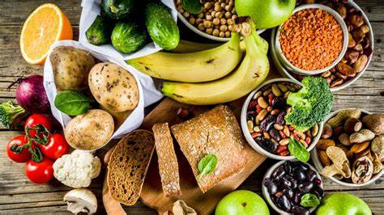
Where should we be?
NHS Eatwell / Planetary health / Mediterranean diet
Public find the messaging confusing
Government recommendations are consistent since 2015 (when max sugar was halved and fibre increased)

Slide 4
Eat food not too much mostly plants
Michael Pollan

Slide 5
But…..
It is three times more expensive to get the energy we need from healthy foods than unhealthy foods
The most deprived decile households would spend 75% of the disposable income on the Eatwell diet
It is harder to buy healthy foods in deprived parts of the UK – there is also a higher density of fast food outlets in these areas

Slide 6
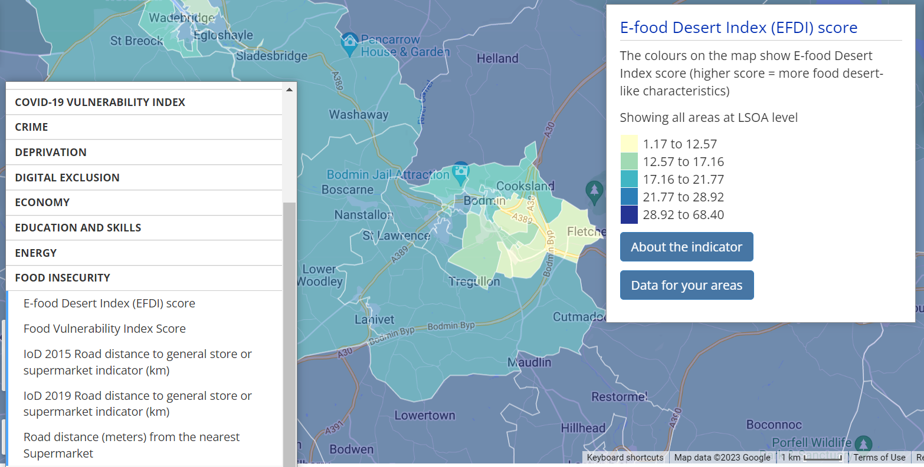
Cornwall Community Insights profile Local Insight (communityinsight.org)

