Slide 1
Lucy Jones Co-founder, The Cornish Food Box Company
SUSTAINABLE FOOD SUMMIT
Building an economically viable food system
Notes:
Thank you for having me in today to talk to about The Cornish Food Box, who we are, what we do, and how you can support local by shopping with us!

Slide 2
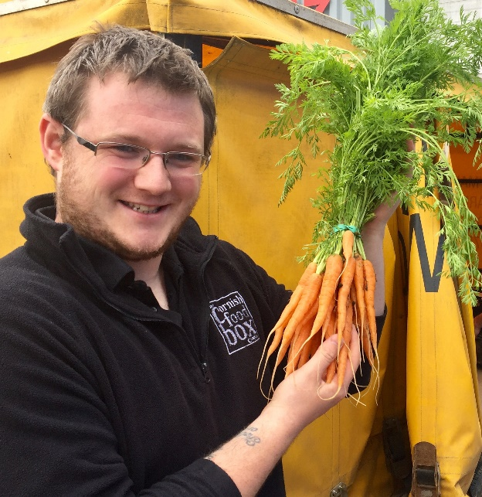
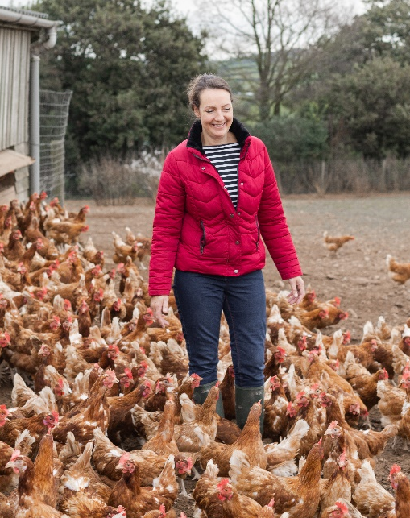
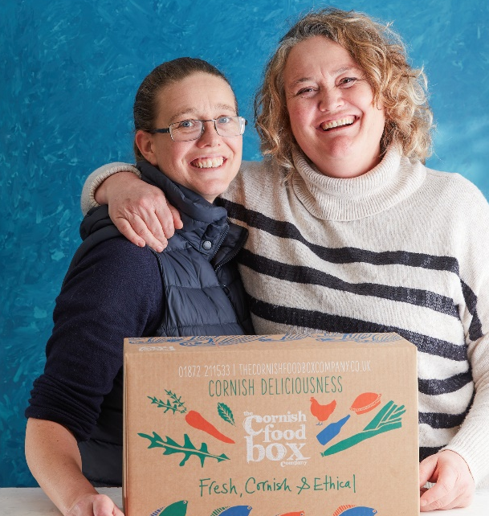
Who Are We?
Ecommerce grocery delivery business
Specialists in delivering Cornwall’s finest produce across Cornwall & the UK
Started in 2010 by Tor & Lucy
Food for the weekly shop that supports the Cornish economy
Corporate hampers, foodie gifts, and holiday cottage welcome packs
Notes:
Tor and I are sisters, we set up the business in 2010 with the aim of delivering fresh local produce to your door.
Since then we have grown a bit… We have now delivered over 80,000 orders across Cornwall and the UK
We work closely with a number of holiday agencies and corporate customers producing bespoke hampers, welcome packs, apology gifts, and staff rewards.
This is in addition to the ‘bread and butter’ work of delivering peoples weekly groceries.

Slide 3
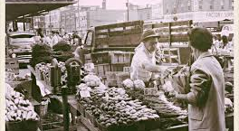
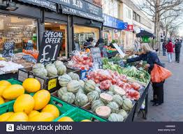
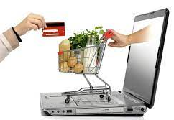
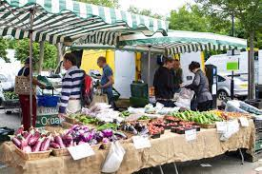
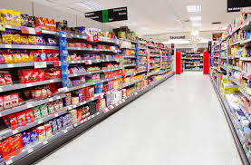
How we shop has changed over the past 50 years...
and this has a massive impact on our farming industry, our environment and rural economy.
Notes:
The way we shop for food & what we buy has changed drastically over the past 50 years.
From small local shops selling primarily locally produced foods. Fresh bought daily.
Close connection between food production and the end consumer.
People knew where their food came from and often who produced it.
To large global network trading goods produced on an industrial scale.
This has led to:
Greater variety of goods sold in large shops
Techniques and additives to make food which keeps longer & can travel further
The weekly shop where food is purchased in bulk
Move to Ready meals & less cooking meals from scratch with all the pros and cons this has
And also Massive environmental and social changes
Changing again –
to very large and very small scale.
Resurgence of the artisan and specialist. Partial back lash against the supermarket.
However loss of cooking skills & time plus a Take out culture. How many of us sit down to watch masterchef with a takeaway on our lap?
- Semi prepared foods, Recipe boxes may help to get people cooking again.
Changes are driven by technology and social changes. But they are pushed by consumer desire and they have massive impacts on the world around us.
So how we shop & what we buy matters. It defines us and it is a demonstration of the values and beliefs we hold dear.

Slide 4
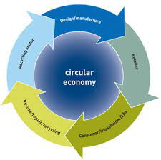
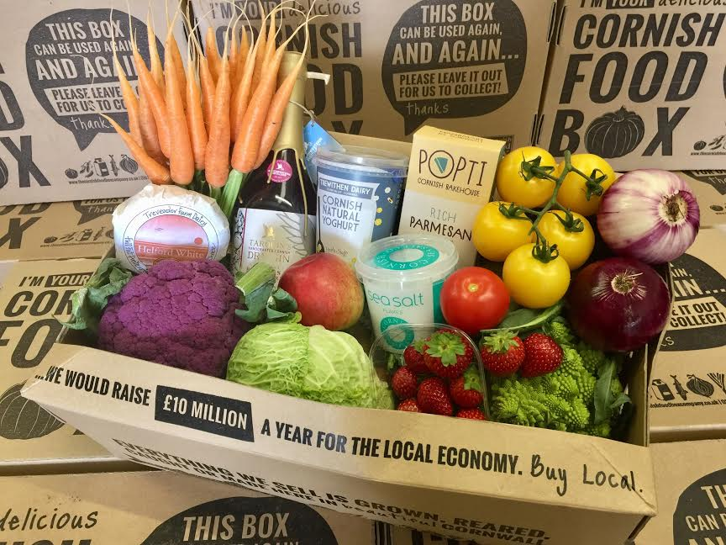
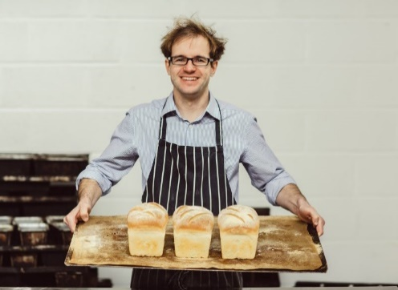
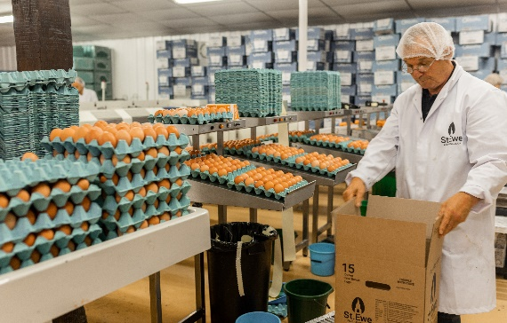
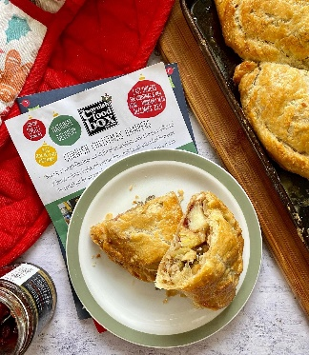
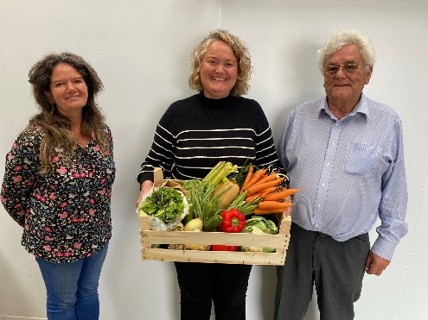
Why is buying local food good for all of us?
Economic Growth for Cornwall - Circular economy, jobs, investment, upskilling
Traceability & trustworthiness
Secure future for our rural community
Better for the environment – recyclable packaging, low food miles, sustainable production
Notes:
Supporting our local economy,
giving consumers confidence in the food the eat,
ensuring a secure future for our farmers and food producers who are the backbone of our rural community
And helping to look after our environment locally and globally
Now
over 250 suppliers and about 2500 product lines. We are proud to have helped many smaller food businesses and growers get their produce to the customer enabling them to grow their businesses
Future – expanding sustainable and local food further in to the holiday cottage and corporate hamper

Slide 5
As consumers, we all have the power to make a difference by the choices we make everyday.
Notes:
Although Cornwall has developed as a foodie destination with local produce appearing on most restaurant menus the weekly family shop still mostly takes place in the supermarkets. Just 17% of fruit and veg in supermarkets is produced locally – vast majority comes from overseas.
At the CFB this is something we want to change by giving customers an convenient alternative way to buy food & drink which meets customers environmental and ethical values.

Slide 6
Ecommerce Platform
~ 250 PRODUCERS & 1500 PRODUCTS
UK WIDE 5 DAY/WEEK DELIVERIES
BOXES & INDIVIDUAL ITEMS
SUBSCRIPTION OR ONE-OFF ORDERS

Slide 7
A Sustainable & Economically Viable Food System…How do we achieve this?
1: Food production must be commercial
2: Accessible to all
3: Education
4: Support producers
5: Collaboration
6: Investment

Slide 8
Any questions?
www.thecornishfoodboxcompany.co.uk
lucy@thecornishfoodboxcompany.co.uk
01872 211533

