Slide 1
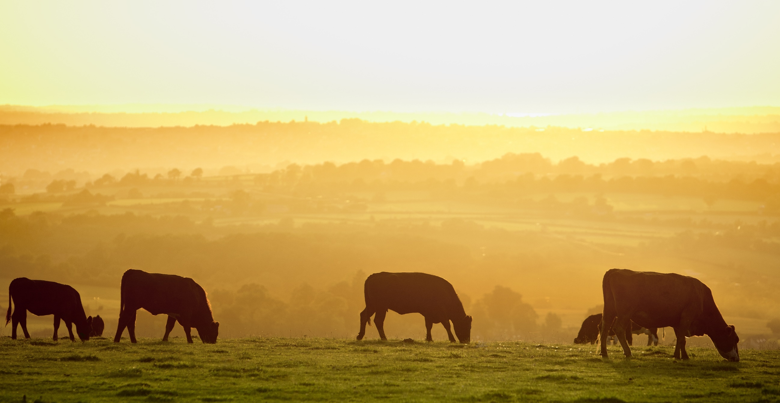


Do we need a new model for Food & Farming?
Dr Robin Jackson
Director, Rural Business School

Slide 2
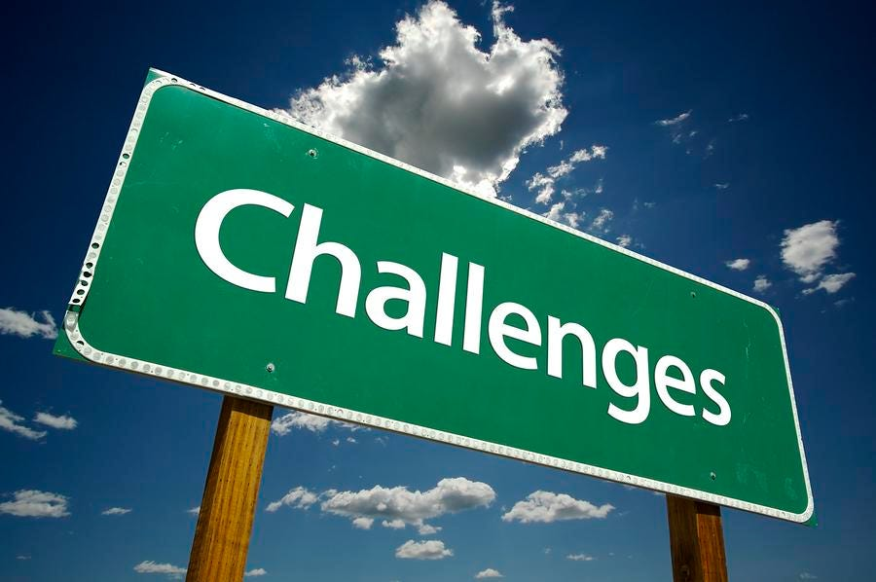

Slide 3

Economic
finance, inflation, competition and labour
Environmental
pollution, climate change and declining biodiversity
Societal
diseases, healthy diets, access and heritage

Slide 4
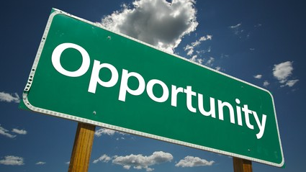

Slide 5
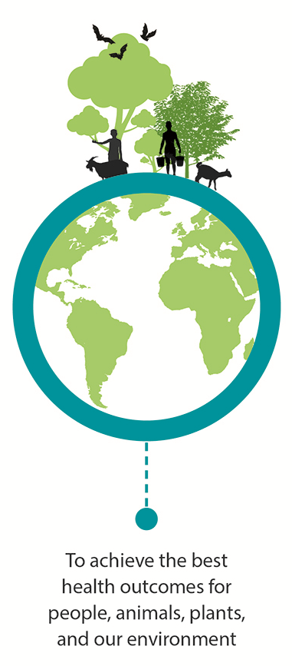
One Health
“…. the goal of achieving optimal health outcomes recognizing the interconnection between people, animals, plants, and their shared environment.”
CDC – Centre for Disease Control & Prevention
To achieve the best health outcomes for people, animals, plants and our environment

Slide 6
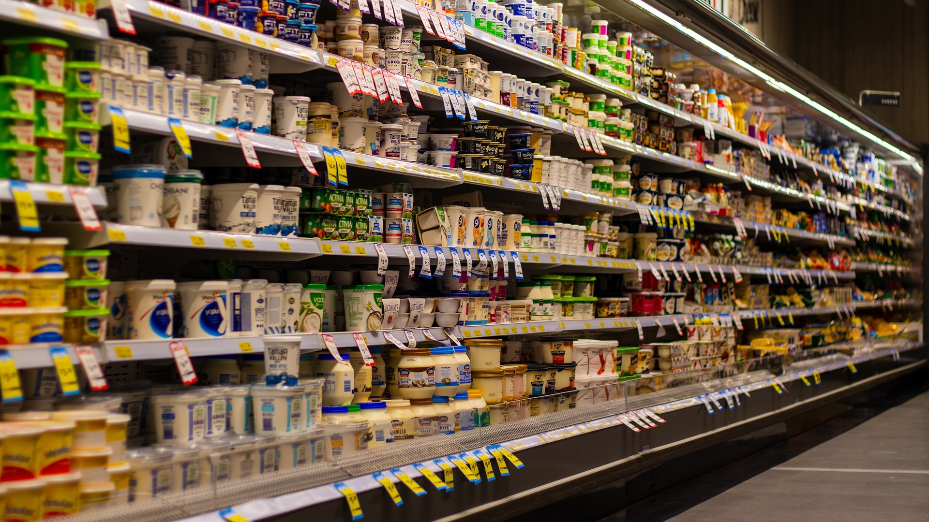
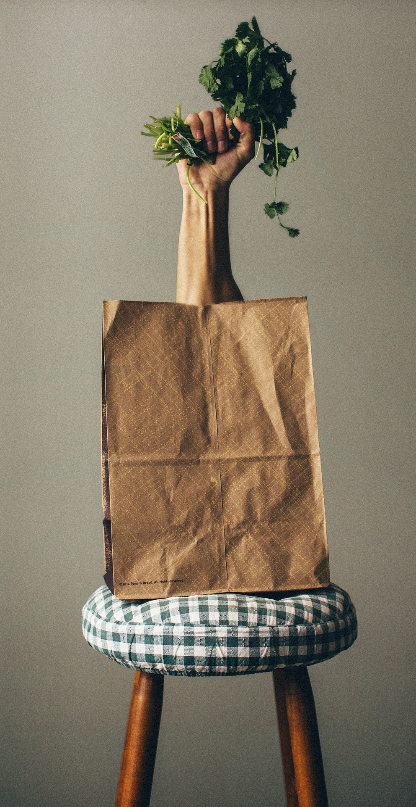
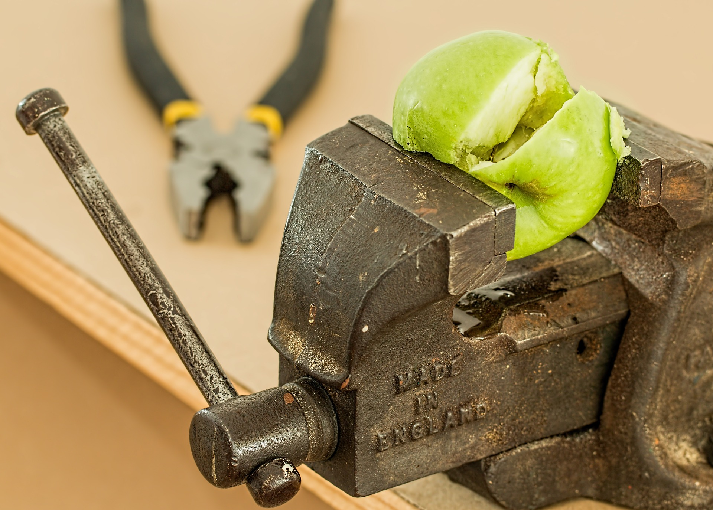

Slide 7
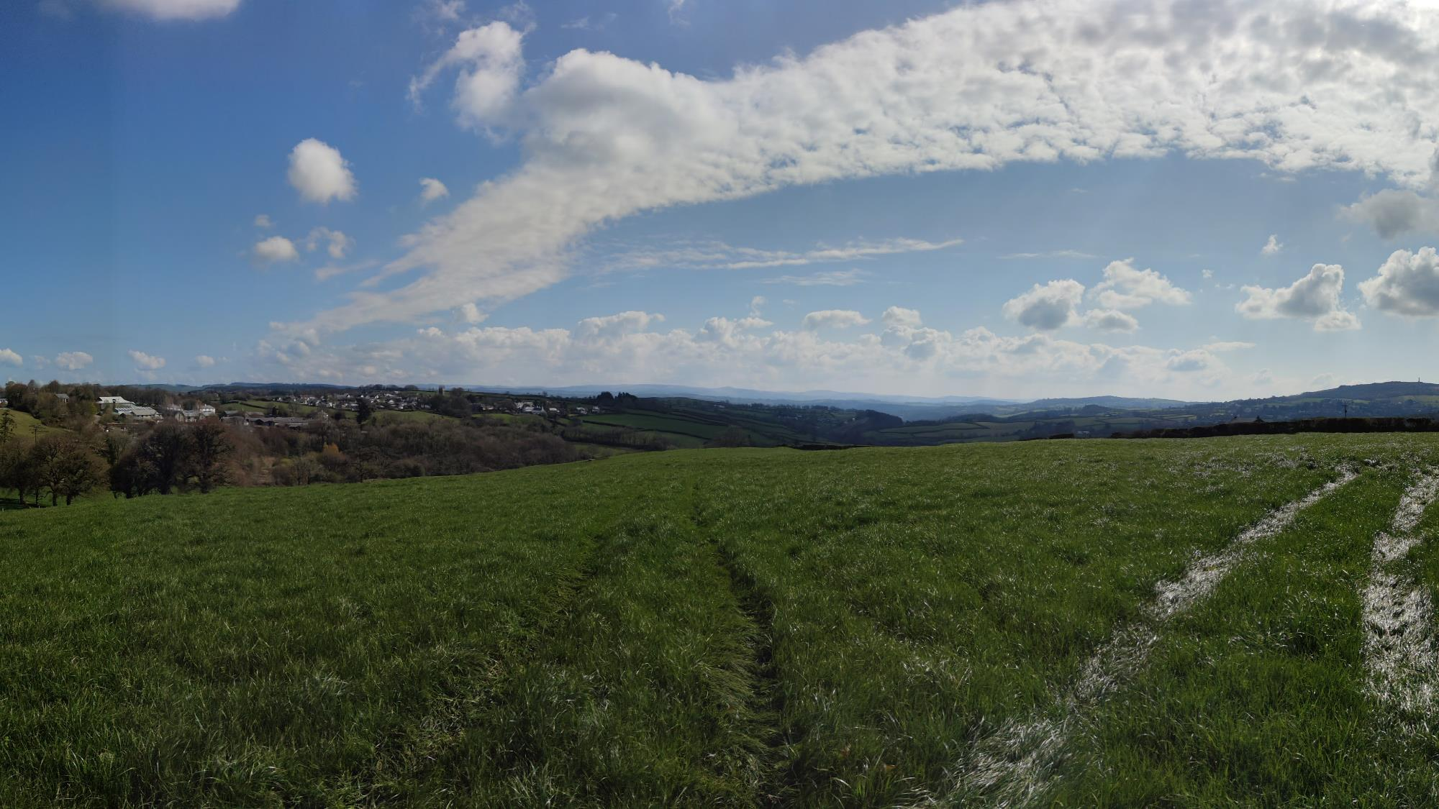
Entrenched versus Visionary
Supply Chain Ecosystem
Value based Values based
Optimisation Transformation
Hold power Empower
Workers People
Production focus Consumer focus
Food as a Commodity As a Force for Good
Growth orientated Purpose orientated
Value of Data Value from Data
vs
vs
vs
vs
vs
vs
vs
vs
vs

Slide 8
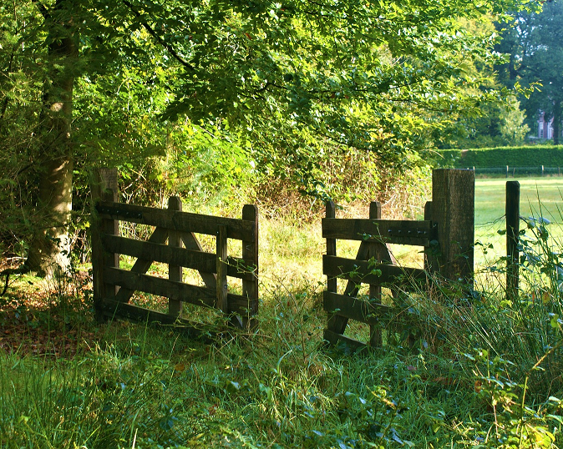
Beyond the Farm Gate
Through supply chains & eco-systems
Trust based ledgers
Evidencing impact
Provenance
Rewards
It’s more than just Production. It’s getting to market, reducing waste, educating, informing, and realising value

