Slide 1
Cornwall Food Systems Summit May 2023
Matt Chatfield
Cornwall in my Kitchen: Tamar Valley Farmer

Slide 2
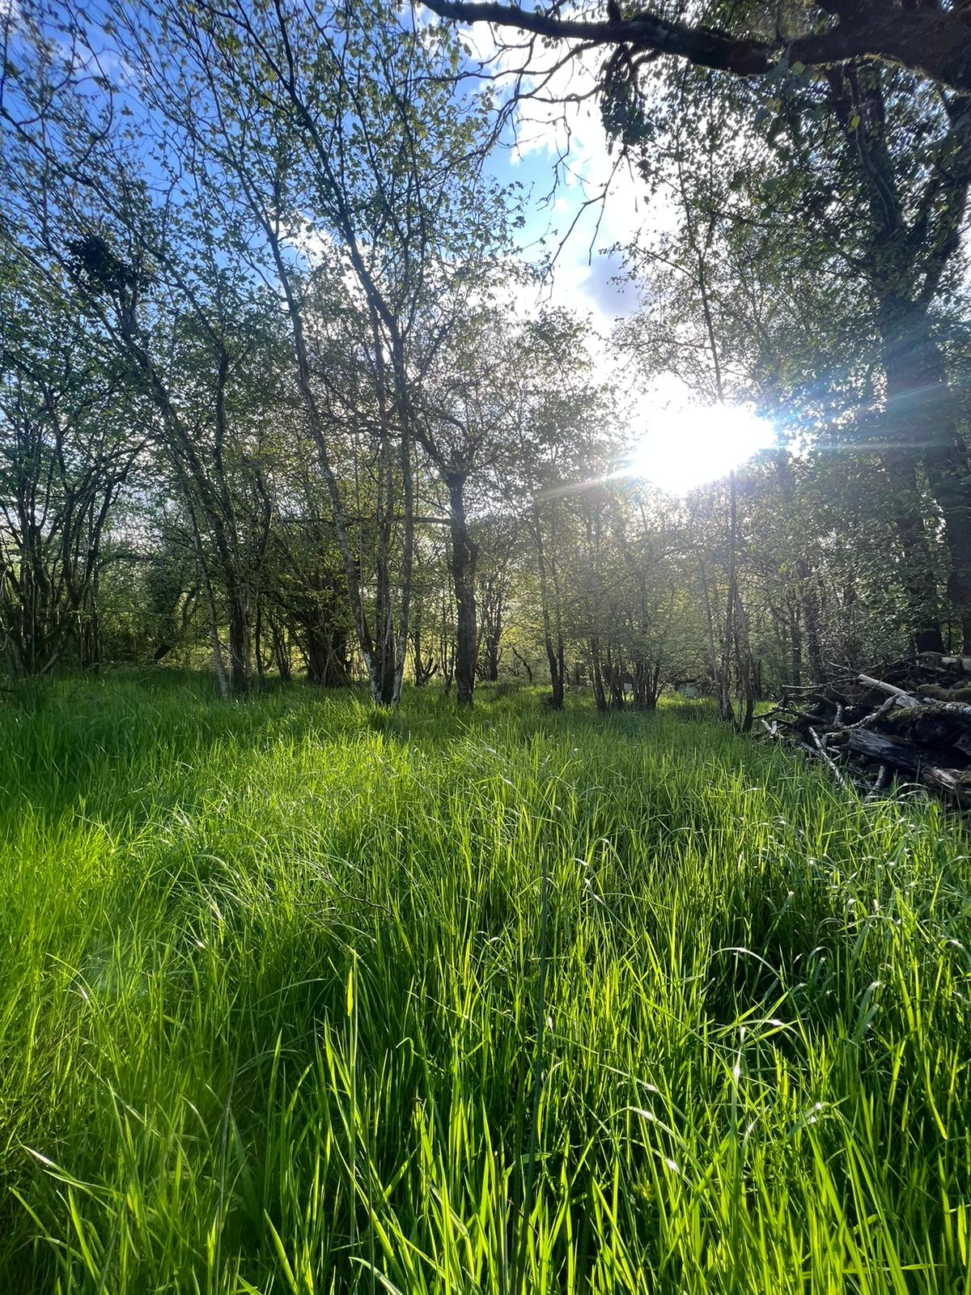
12 months and 50 meters apart

Slide 3
