Slide 1





People &
Society

Slide 2
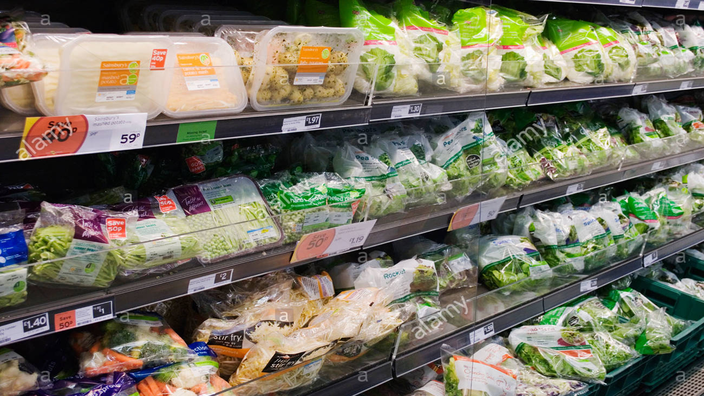

Cheap convenience = more waste
Cheap convenience = farmers not paid enough
Cheap convenience = mixed, family farms disappear
Cheap convenience = more industrial agriculture
Cheap convenience = massive environmental impacts
Cheap convenience = societal shift to not give food time
Cheap convenience = less nutritious food
Cheap convenience = more ill health
Cheap convenience = people less able to work & pay tax
Cheap convenience = less money around for good
Cheap convenience = more burden on the state
Cheap convenience = more housing and care needs etc
NOT CHEAP OR CONVENIENT
Notes:
Such a choice of cheap, convenient food needs to become more expensive as it kills us, makes us so ill we cant work, polluting our landscape so badly we cant fish and puts such terrible pressures on farmers and the land .
Soil health is reduced – gut health is reduced and so the cycle of negative is increased.
Supermarkets are trying but slowly.

Slide 3

ADAPT OUR TASTES
ADAPT OURSELVES
ADAPT SOCIETY

Slide 4
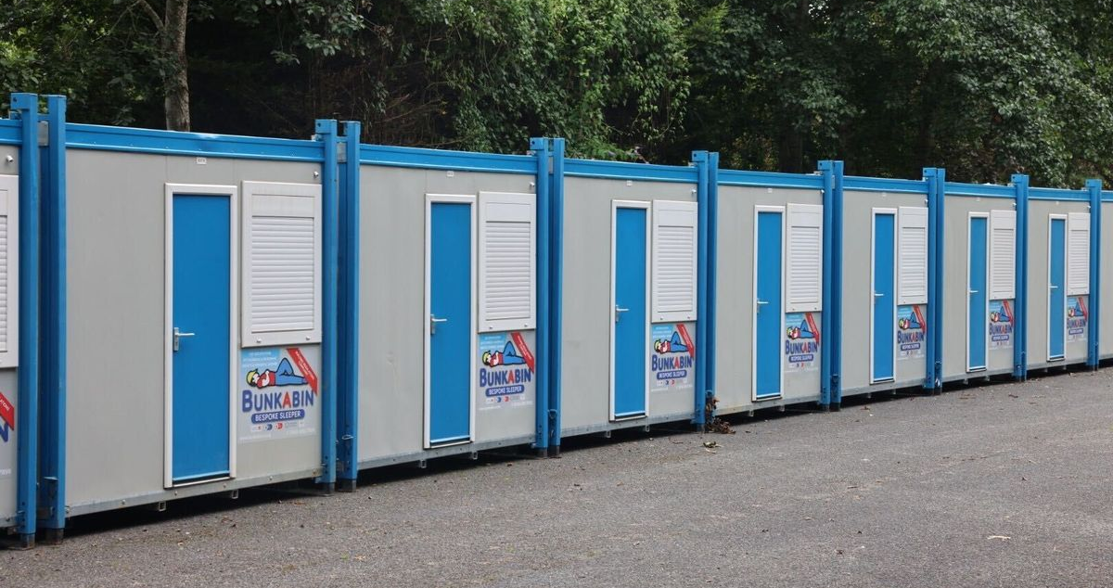
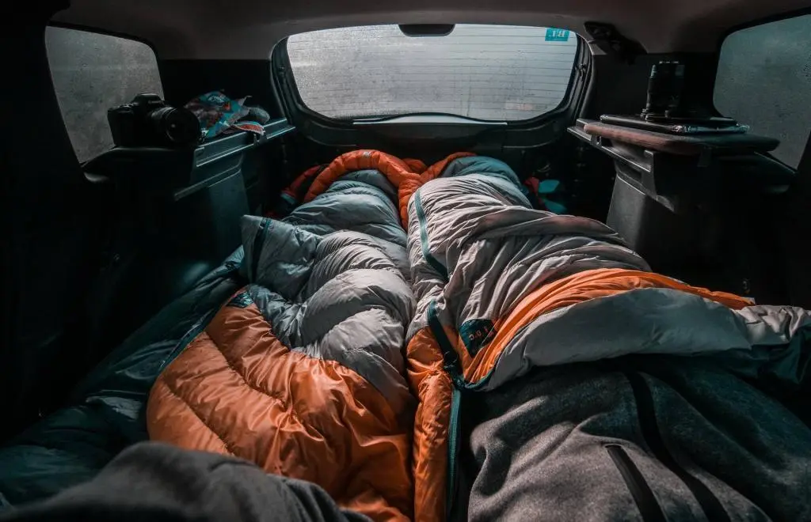
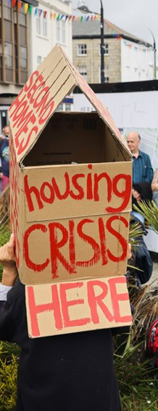
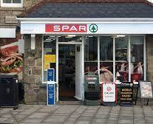
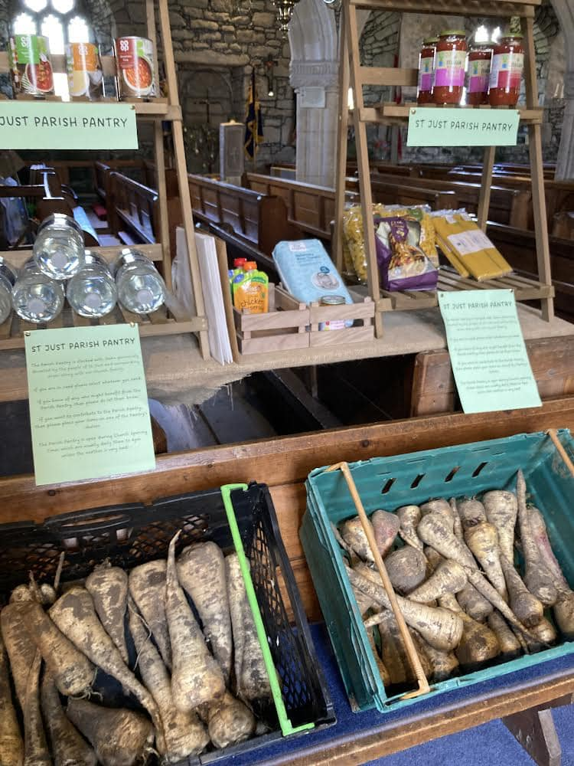

PLANNING REGULATIONS NEED UPDATING URGENTLY

Slide 5

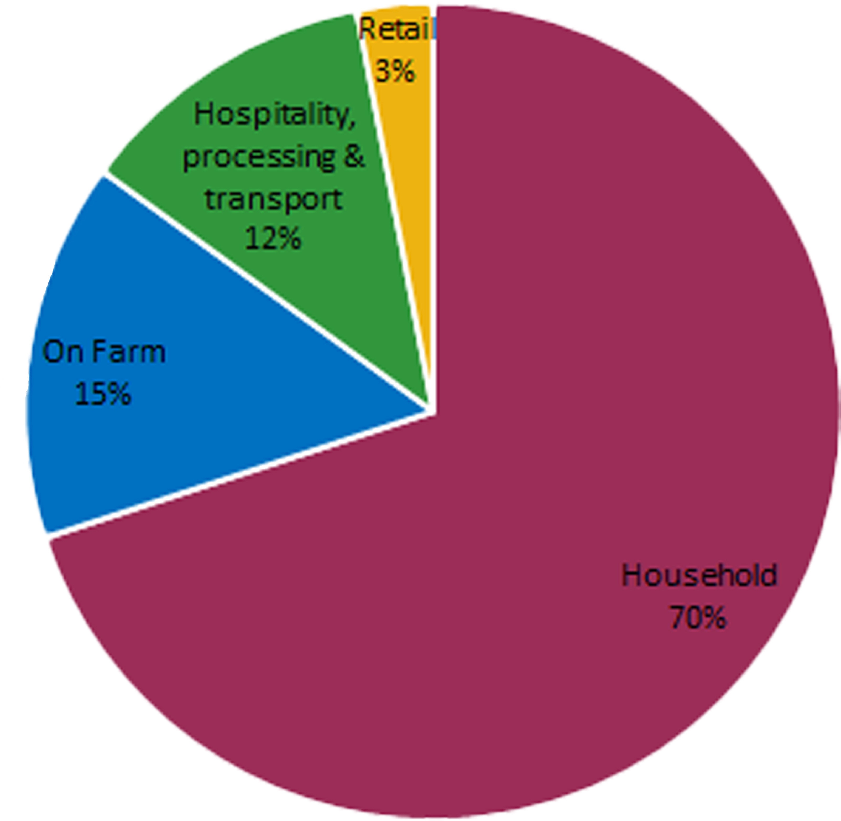
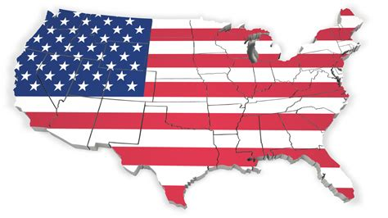
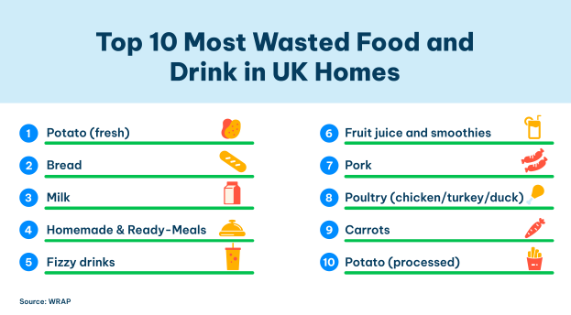
FOOD WASTE
IN THE UK

Slide 6
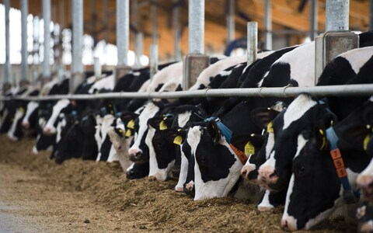
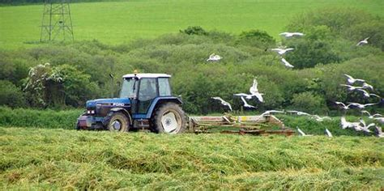
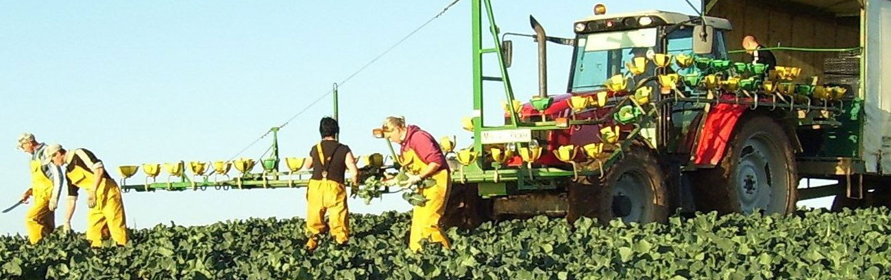

Slide 7
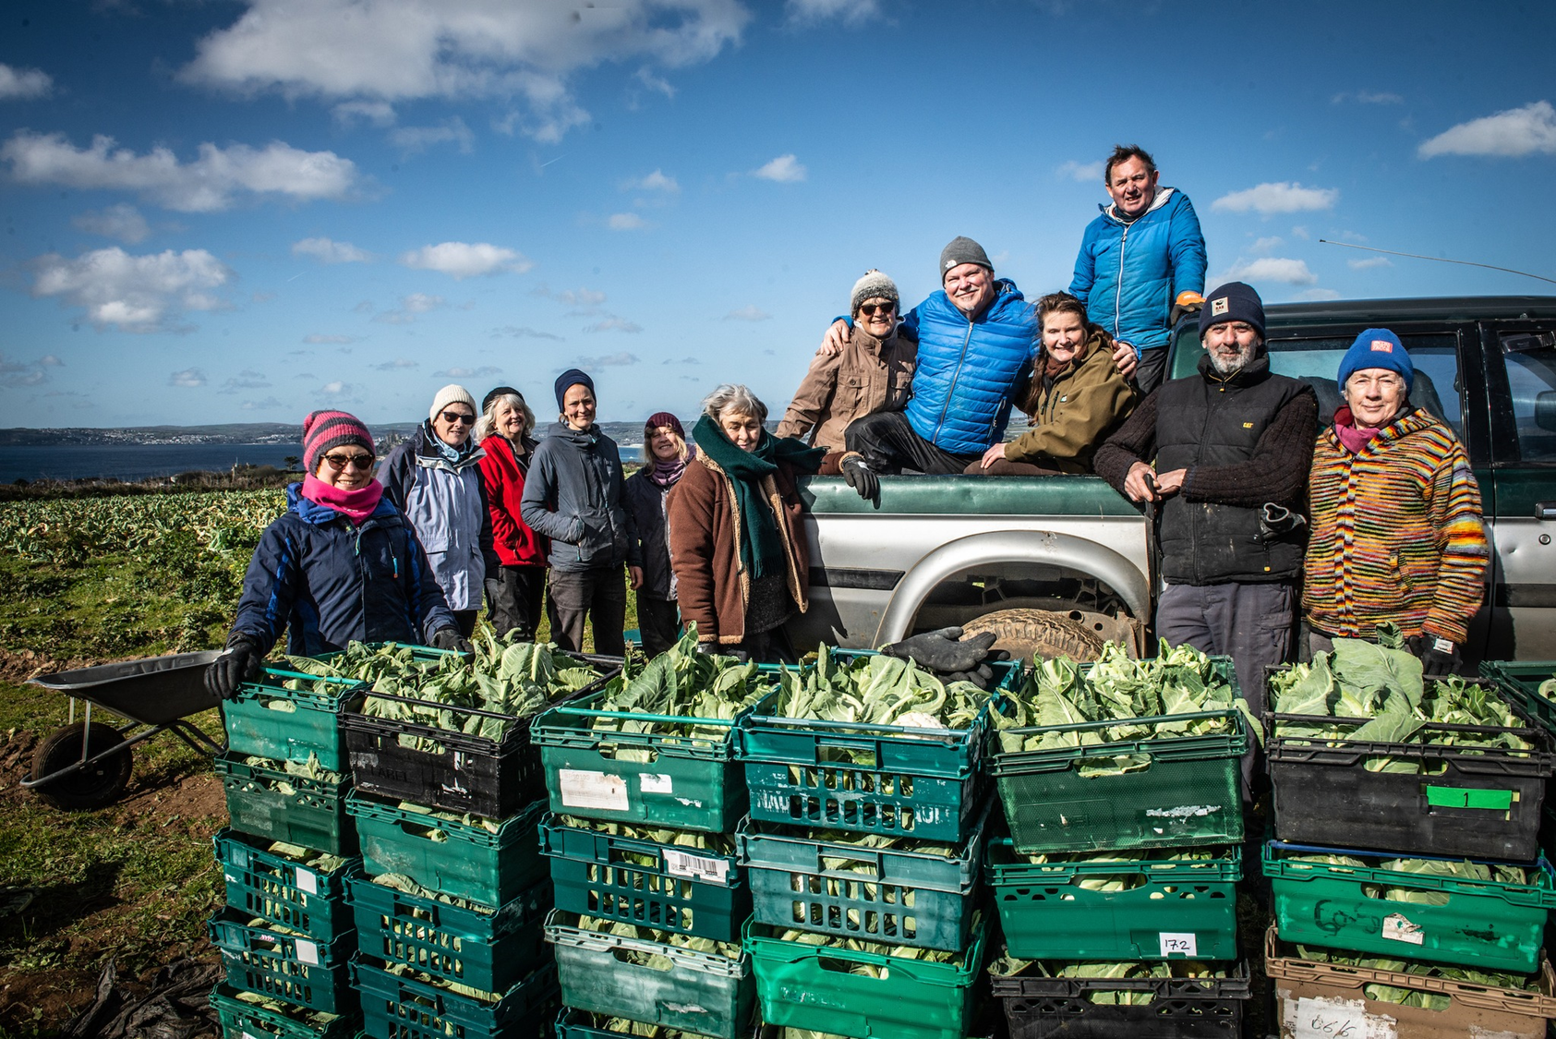

Slide 8
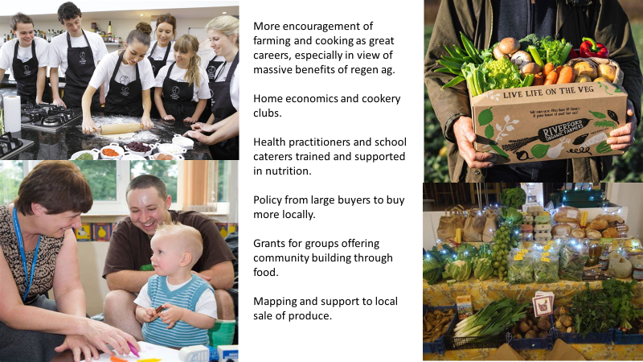

Slide 9

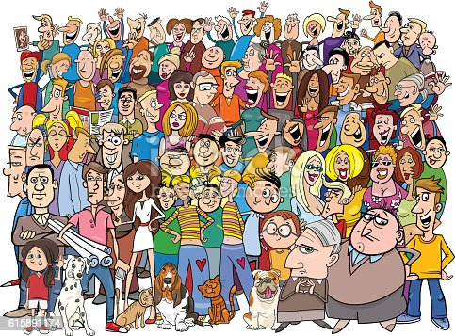


Slide 10
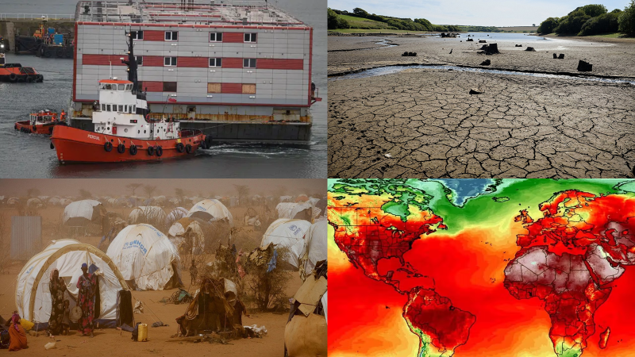
REMAIN HUMANE

Slide 11



